Slide 1
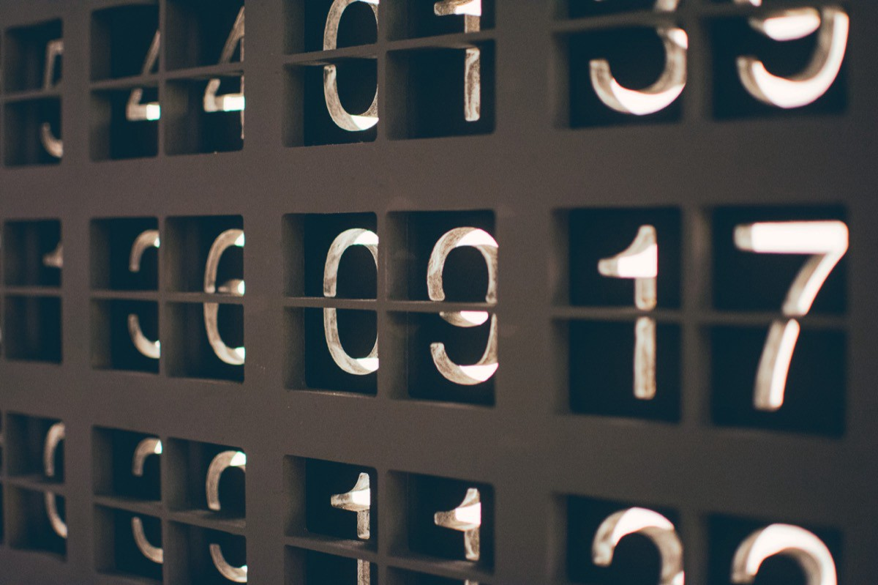




Supervised & Unsupervised Encoding Schemes of Binary Variables for Prediction Performance Enhancement
Institute of Industrial Engineering, NTU
Yun-Hao Yang, Jakey Blue
Notes:
Hi every one, I am Yun-Hao yang, form the Institute of Industrial Engineering of NTU. I am glad I can be here to share the topic, which is about variable encoding for binary features.

Slide 2
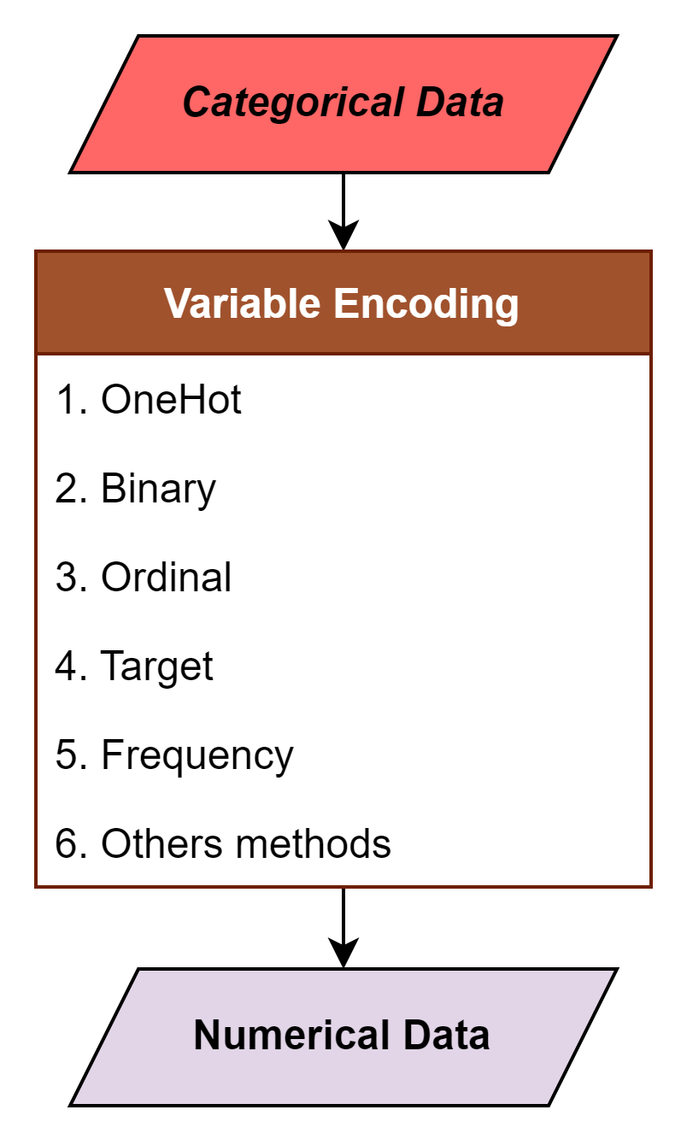
Motivation
Shape
■
▲
●
Categorical |  | Numerical
City |  | Ordinal | Binary |  | One Hot |  |  |  | Frequency
Taipei |  | 0 | 0 | 0 | 0 | 0 | 0 | 1 | 0.2
New York |  | 1 | 0 | 1 | 0 | 0 | 1 | 0 | 0.2
London |  | 2 | 1 | 0 | 0 | 1 | 0 | 0 | 0.2
Tokyo |  | 3 | 1 | 1 | 1 | 0 | 0 | 0 | 0.4
Tokyo |  | 3 | 1 | 1 | 1 | 0 | 0 | 0 | 0.4
ENCODER
■ | ▲ | ●
0 | 0 | 1
0 | 1 | 0
1 | 0 | 0
Notes:
while doing Data pre-processing, variable encodings help us transform the categorical data into numerical, most of them assigning numerical value to each type in the feature, like ordinal, frequency, and target encoding.
Among all, One Hot encoding is also a commonly used methods, for its convenience and efficiency. Unlike other methods, One Hot encoding creates dummy columns for each type in the categorical feature. And represent original data into binary

Slide 3
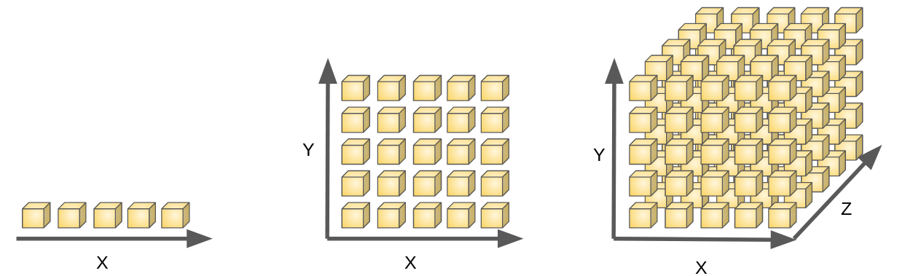
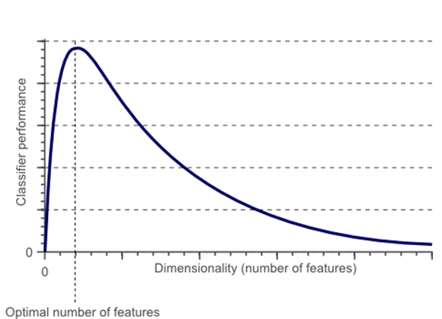
Motivation
Categorical | Animal
 | Cow
 | Tuna
 | ⁝
 | Frog
One Hot
Binary | Animal
 | Tuna | Cat | Frog | Cod | Goat | Dog | … | Cow
 | 0 | 0 | 0 | 0 | 0 | 0 |  | 1
 | 1 | 0 | 0 | 0 | 0 | 0 |  | 0
 | ⁝ | ⁝ | ⁝ | ⁝ | ⁝ | ⁝ |  | ⁝
 | 0 | 0 | 1 | 0 | 0 | 0 |  | 1
Notes:
Unfortunately, If the categorical feature has numerous types, one hot encoding will largely expand the dimension of the data, and might trigger the curse of the dimensionality, causing ML model perform poorly.
The reason why is mainly due to too many features encumber the classification model in making decision

Slide 4
Motivation
Categorical | Animal | Size | Color
 | Cow | Big | White
 | Tuna | Med | Black
 | ⁝ | ⁝ | ⁝
 | Frog | Tiny | Green
Other Encoding
Numerical | Animal | Size | Color
 | 10 | 4 | 7
 | 2 | 3 | 6
 | ⁝ | ⁝ | ⁝
 | 7 | 1 | 3
One Hot
Binary | Animal |  |  |  |  |  |  |  | Size |  |  |  | Color
 | Tuna | Cat | Frog | Cod | Goat | Dog | Toad | Cow | Large | Mid | Small | Tiny | White | Black | Red | Blue | Green | Gray
 | 0 | 0 | 0 | 0 | 0 | 0 | 0 | 1 | 1 | 0 | 0 | 0 | 1 | 0 | 0 | 0 | 0 | 0
 | 1 | 0 | 0 | 0 | 0 | 0 | 0 | 0 | 0 | 1 | 0 | 0 | 0 | 1 | 0 | 0 | 0 | 0
 | ⁝ | ⁝ | ⁝ | ⁝ | ⁝ | ⁝ | ⁝ | ⁝ | ⁝ | ⁝ | ⁝ | ⁝ | ⁝ | ⁝ | ⁝ | ⁝ | ⁝ | ⁝
 | 0 | 0 | 1 | 0 | 0 | 0 | 0 | 1 | 0 | 0 | 0 | 1 | 0 | 0 | 0 | 0 | 1 | 0
Notes:
The common way to prevent the problem is simply encode with others methods, instead of presenting categorical data in numerous binary columns.
Imagine we receive one hot encoded data as original input, with many grouped binary features, we can reverse the data back to categorical, then choose another method to solve the dimensionality problem.

Slide 5


Motivation
Numerical | Group 1 | Group 2 | Group 3
 | 10 | 4 | 7
 | 2 | 3 | 6
 | ⁝ | ⁝ | ⁝
 | 7 | 1 | 3
When the data is not follow the One Hot rule, can’t use other method to transform the binary data. If only can we find a way in representing the numerous binary features data in a much simple way...
Binary | Tuna | Cat | Frog | Cod | Goat | Dog | Toad | Cow | Large | Mid | Small | Tiny | White | Black | Red | Blue | Green | Gray
 | 0 | 0 | 0 | 0 | 0 | 0 | 0 | 1 | 1 | 0 | 0 | 0 | 1 | 0 | 0 | 0 | 0 | 0
 | 1 | 0 | 0 | 0 | 0 | 0 | 0 | 0 | 0 | 1 | 0 | 0 | 0 | 1 | 0 | 0 | 0 | 0
 | ⁝ | ⁝ | ⁝ | ⁝ | ⁝ | ⁝ | ⁝ | ⁝ | ⁝ | ⁝ | ⁝ | ⁝ | ⁝ | ⁝ | ⁝ | ⁝ | ⁝ | ⁝
 | 0 | 0 | 1 | 0 | 0 | 0 | 0 | 1 | 0 | 0 | 0 | 1 | 0 | 0 | 0 | 0 | 1 | 0
Notes:
But, what if the data we got in first hand is not grouped binary? What if there are too many binary features to deal with? There is no way to revered this non-grouped binary data to categorical like the previous slide. Is there a better way to describe, or encode this kind data?

Slide 6
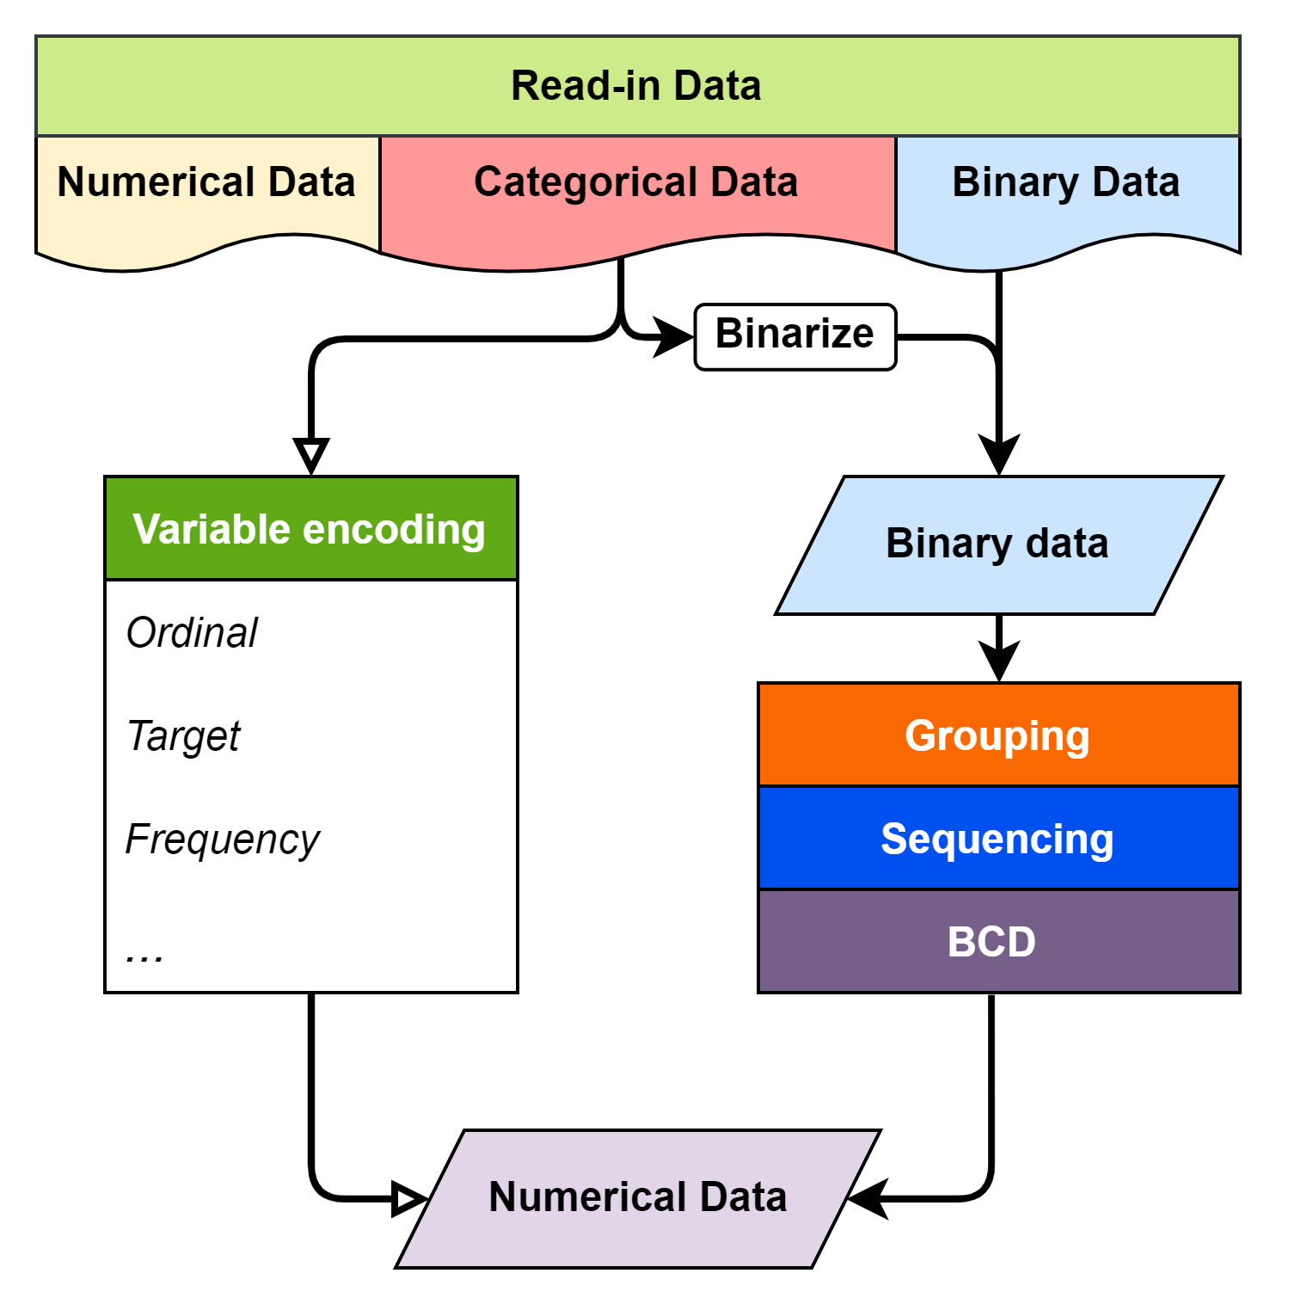
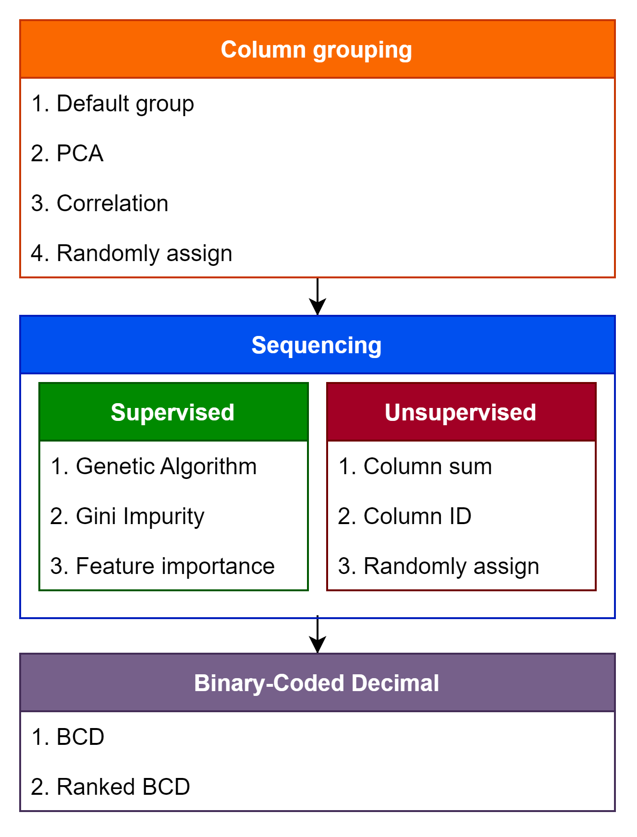
Methodology
Col 6 | Col 2 | Col 5 | Col 4 | Col 1 | Col 3
0 | 1 | 0 | 1 | 1 | 0
0 | 0 | 1 | 1 | 1 | 0
⁝ | ⁝ | ⁝ | ⁝ | ⁝ | ⁝
1 | 0 | 1 | 0 | 0 | 1
Notes:
As the traditional encoding is only for categorical part. In the research, we try to develop a variable encoding method built for binary data, which is able to transform non-grouped binary into numerical, within these 3 steps: column Grouping, Sequencing, and binary-coded decimal. The following animation will show how these steps works.

Slide 7
Methodology
Group
Sequence
BCD
In the research, we propose a method to encode binary data in to numerical data. Via grouping, sequencing and transforming the binary row data with BCD encode.
Grouping similar, correlated features
Sequencing features in each feature group
BCD encode on each feature group
Tiny | Cat | Large | Black | White | Cow
1 | 1 | 0 | 1 | 0 | 0
0 | 0 | 1 | 0 | 1 | 1
⁝ | ⁝ | ⁝ | ⁝ | ⁝ | ⁝
0 | 0 | 1 | 0 | 1 | 1
Col 1 | Col 2 | Col 3 | Col 4 | Col 5 | Col 6
1 | 1 | 0 | 1 | 0 | 0
1 | 0 | 0 | 1 | 1 | 0
⁝ | ⁝ | ⁝ | ⁝ | ⁝ | ⁝
0 | 0 | 1 | 0 | 1 | 1
Notes:
As we gather the non-grouped binary data, there might be some relationship between columns, yet we don’t know about it.

Slide 8
Methodology
Group
Sequence
BCD
In the research, we propose a method to encode binary data in to numerical data. Via grouping, sequencing and transforming the binary row data with BCD encode.
Grouping similar, correlated features
Sequencing features in each feature group
BCD encode on each feature group
Tiny
1
0
⁝
0
Cat
1
0
⁝
0
Large
0
1
⁝
1
Black
1
0
⁝
0
White
0
1
⁝
1
Cow
0
1
⁝
1
Notes:
In grouping phase, hoping by the feature selection method can find this kind of relationship.
In this case, we successfully group the columns by their physical meaning, which is animal types, colors, and sizes.

Slide 9
Methodology
Group
Sequence
BCD
In the research, we propose a method to encode binary data in to numerical data. Via grouping, sequencing and transforming the binary row data with BCD encode.
Grouping similar, correlated features
Sequencing features in each feature group
BCD encode on each feature group
Cat
1
0
⁝
0
Cow
0
1
⁝
1
Black
1
0
⁝
0
White
0
1
⁝
1
Tiny
1
0
⁝
0
Large
0
1
⁝
1
Notes:
Secondly in the sequencing phase, for generating a more competitive numerical value, we need to rearrange the sequence of columns in groups. The detail and the reason why will be explained later on

Slide 10
Methodology
Group
Sequence
BCD
In the research, we propose a method to encode binary data in to numerical data. Via grouping, sequencing and transforming the binary row data with BCD encode.
Grouping similar, correlated features
Sequencing features in each feature group
BCD encode on each feature group
Cow | Cat | White | Black | Tiny | Large
0 | 1 | 0 | 1 | 1 | 0
1 | 0 | 1 | 0 | 0 | 1
⁝ | ⁝ | ⁝ | ⁝ | ⁝ | ⁝
1 | 0 | 1 | 0 | 0 | 1

Slide 11
Methodology
Group
Sequence
BCD
In the research, we propose a method to encode binary data in to numerical data. Via grouping, sequencing and transforming the binary row data with BCD encode.
Grouping similar, correlated features
Sequencing features in each feature group
BCD encode on each feature group
Animal | Color | Size
1 | 1 | 2
2 | 2 | 1
⁝ | ⁝ | ⁝
2 | 2 | 1
Notes:
In the last step, with the binary – code decimal, we can represent columns into numerical values. And that’s it, we have generated a both understandable and tidy dataset with numerical value form the non-grouped binary data.

Slide 12

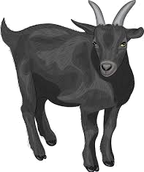
Methodology - Grouping
Group
Sequence
BCD
Binary Data (Total:300 sample, 200 good, 100 bad)
Animal
Cow | Cat | Goat | Dog | Frog | Toad | Tuna | Cod
 |  | V
counts
Size
Large | Mid | Small | Tiny
 | V
counts
Color
White | Black | Gray | Red | Blue | Green
 | V
Health Status
Good | Bad
 | V
counts
Notes:
Here is a little example. Assume you are a zookeeper who have to check all animal's health status, and here is the checklist, showing the animal ’s type, size, color, and health status. Each checkbox in same group is exclusive to each other.
After collecting the data of all 300 animals in your zoo, the result is at the right, presenting how many times each checkbox was checked, and what kind of health status the checked animal was.
Like, in the size: mid checkbox, 100 out of 300 samples are checked, and half of them are in the good status, but the other half of them don’t.
Our target is using these 18 checkboxes as binary feature data, on predicting the animal’s health status.

Slide 13
Methodology - Grouping
Group
Sequence
BCD
Binary Data | Grouped by PCA
Notes:
First, we try to find the relationship of these 18 binary features. for now, we used Principle Components Analysis in grouping the columns.
In here, PCA helped us makes 3 different columns groups, via PC1 to PC3.
The main purpose using PCA here is by flittering out the less importance features, we can create groups that contain the most importance ones.

Slide 14
Methodology - Sequencing
Group
Sequence
BCD
Grouped by PCA
Secondly, sequencing features in each group by columns’ attributes, for outputting better BCD values after encode.
Column sum
Type impurity
Feature importance
Notes:
After grouping the features by PCA, we now can rearrange the columns. We had been trying using column sum, impurity, and Feature importance as our sequencing rule.

Slide 15
Methodology - Sequencing
Group
Sequence
BCD
Grouped by PCA | Sequenced by column sum
Notes:
In the right-hand side, we can see the columns have been rearrange with its columns sum decreasingly.
But why bother to rearrange the sequence of the columns? Will this matter?

Slide 16
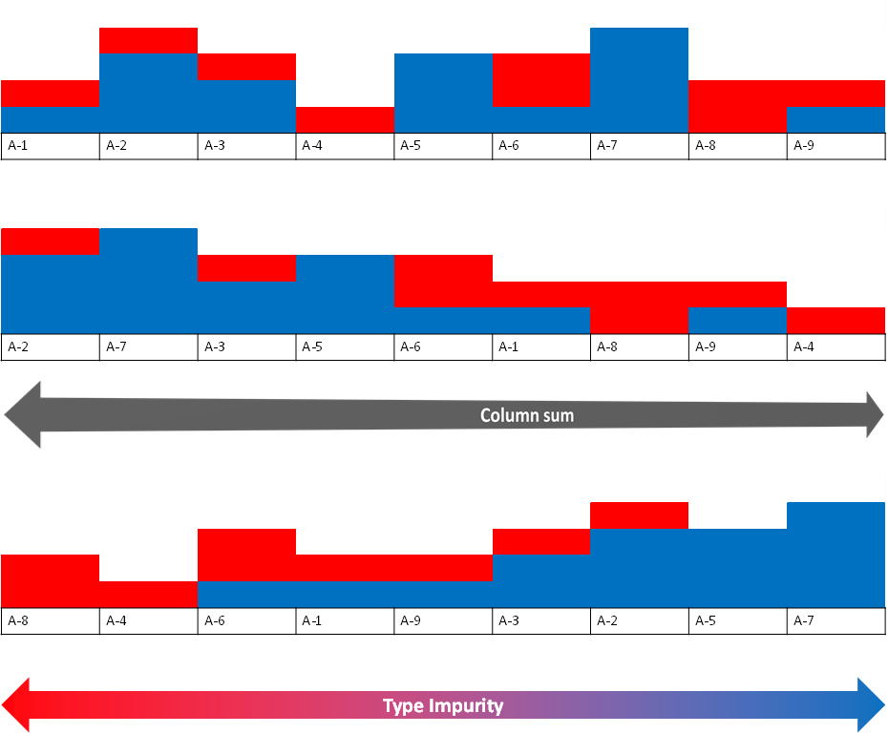
Methodology - Sequencing
Group
Sequence
BCD
Group
Sequence | No Seq.
 | Impurity
BCD value
No Seq.
Impurity
Notes:
In fact, sequencing is decisively importance to the new encoded numerical value. These figures show how the new data will distributed in numerical feature by the sequence at the left, if a certain sequence can make these two types be clearly separated in numerical value, will makes classifier easily to find the cut point in this new feature.
In a nut shell, a good sequence can make our encoded numerical data easier to be classified.

Slide 17
Methodology - BCD code
Group
Sequence
BCD
Group
Sequence
BCD |  | Sorted Column Group |  |  |  |  |  |  | Type
 |  | Blue | Tuna | Tiny | Toad | Green | Cod
33 |  | 1 | 0 | 0 | 0 | 0 | 1 |  | Good
36 |  | 1 | 0 | 0 | 1 | 0 | 0 |  | Good
26 |  | 0 | 1 | 1 | 0 | 1 | 0 |  | Bad
14 |  | 0 | 0 | 1 | 1 | 1 | 0 |  | Bad
Decimal digit | BCD
 | 8 | 4 | 2 | 1
0 | 0 | 0 | 0 | 0
1 | 0 | 0 | 0 | 1
2 | 0 | 0 | 1 | 0
3 | 0 | 0 | 1 | 1
4 | 0 | 1 | 0 | 0
5 | 0 | 1 | 0 | 1
6 | 0 | 1 | 1 | 0
7 | 0 | 1 | 1 | 1
8 | 1 | 0 | 0 | 0
9 | 1 | 0 | 0 | 1
Notes:
But how to transform multiple binary value into numerical by BCD? In the right is the how the BCD works. It basically is by decimalize a sample's grouped columns as binary values. Like the sample here, 2 power 5 plus 2 power 0 is 33 in total.
As you can imagine, if we can put a more Informative column at front, it can determine the BCD value more than other columns do.
Like the color: blue checkbox only checked by the good animals, and putting it at front will largen both their BCD value and their gap to the bad animals on the new numerical feature.
Hence putting informative column at front can help us in output a better numerical value in separating two types.

Slide 18
Methodology - sum up
1. | Column Grouping
 | Clustering related or similar columns together into groups.
2. | Sequencing
 | Rearrange columns in group, for a more distinctive /competitive BCD value.
3. | Binary-Coded Decimal
 | Transform column groups into a numerical value with BCD.
Original
Randomly
Impurity
Notes:
That's the main steps of whole process, the goal of the research is focus on how to find a better grouping and sequencing methods, in order to generate a more easily classified data.

Slide 19
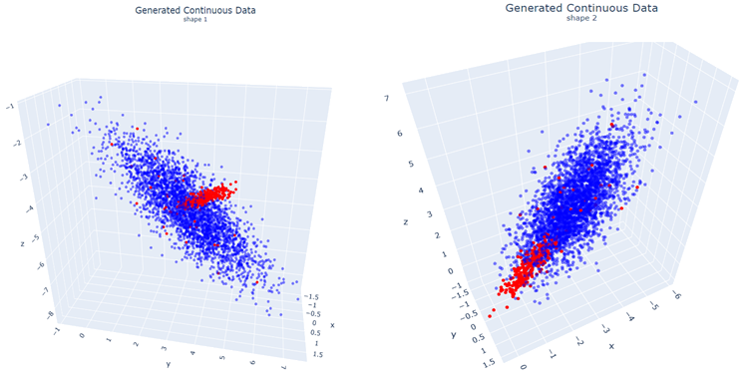

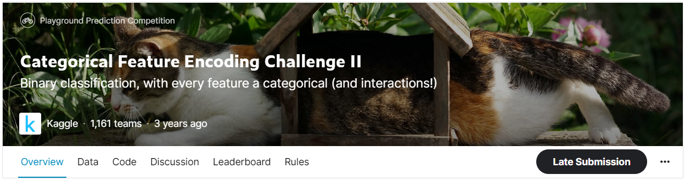
Case study
In Case study, we compare classification results with the commonly used variable encoding method under different datasets.
Simulated datasets
Kaggle dataset
Notes:
In case study we will go through both a simulated, and a Kaggle dataset. To demonstrate our method, and compare with the traditional encoding in the same time.

Slide 20
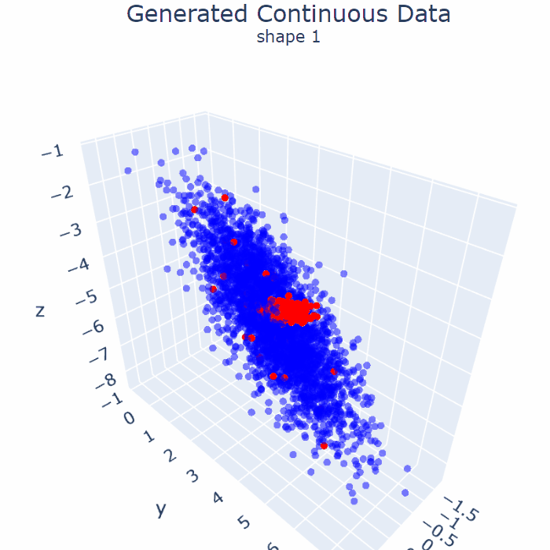
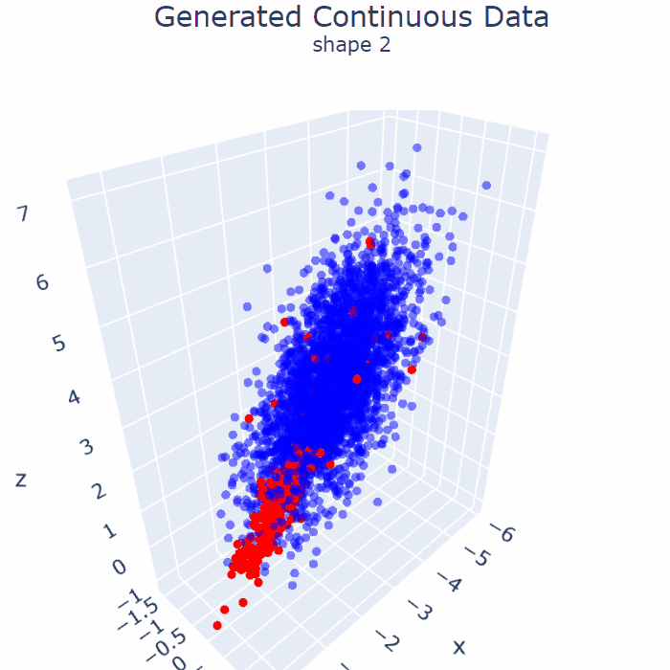
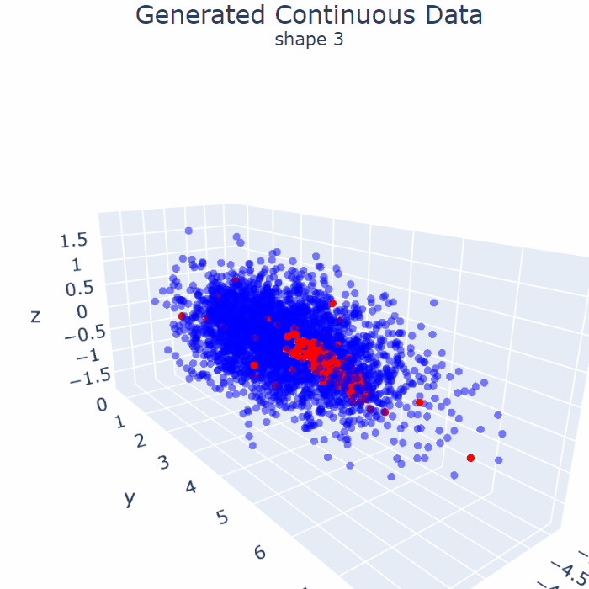
Simulated data (3300 samples, 3000 Good, 300 Bad)
Dataset 1 |  | Dataset 2 |  | Dataset 3
Notes:
These datasets were generated procedurally, with around 3 thousand samples and ten to one ratio in two types, and several noises in the majority. We plan to use its 3 dimensions as our inputs.

Slide 21
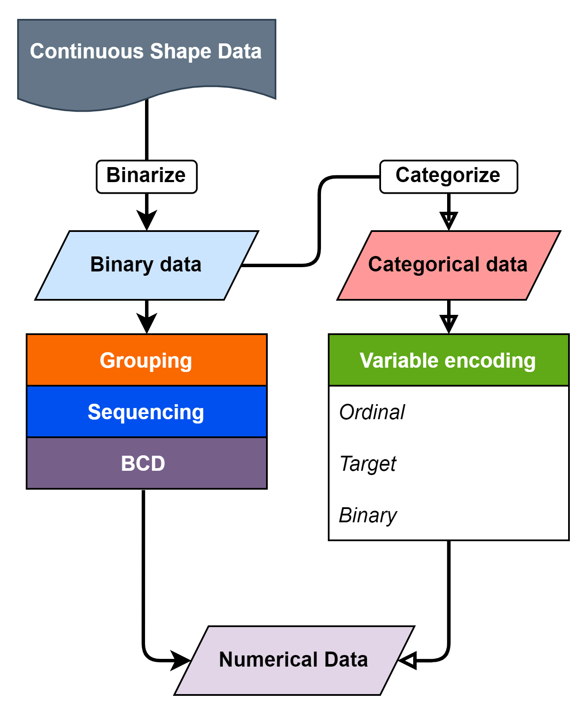
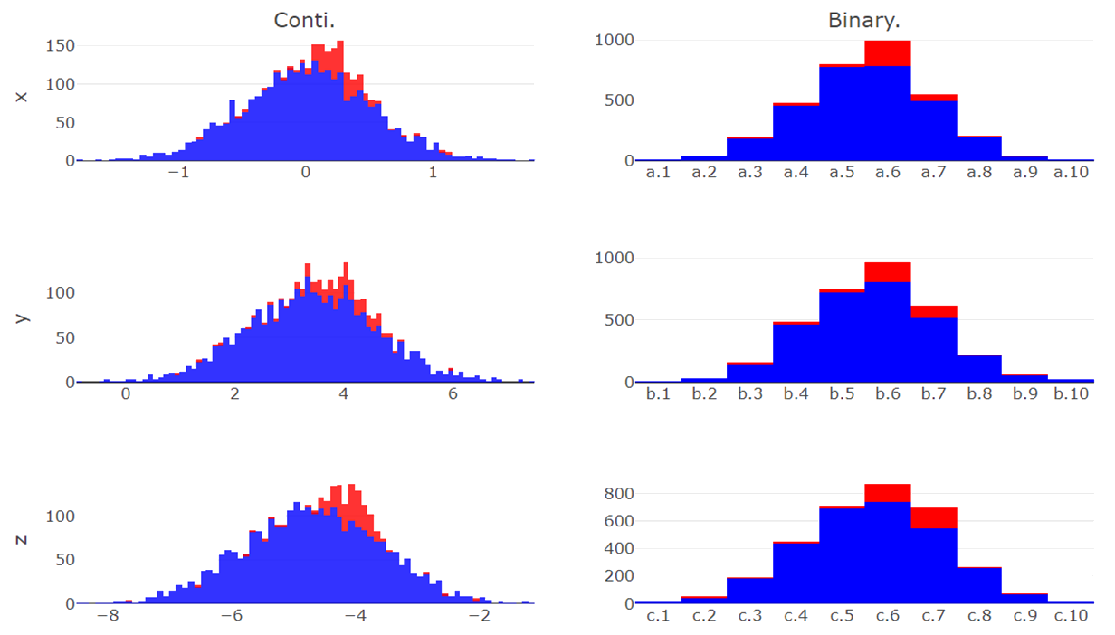
Simulated data - binarize
z.1 | z.2 | z.3 | z.4 | z.5 | z.6 | z.7 | z.8 | z.9 | z.10
y.1 | y.2 | y.3 | y.4 | y.5 | y.6 | y.7 | y.8 | y.9 | y.10
x.1 | x.2 | x.3 | x.4 | x.5 | x.6 | x.7 | x.8 | x.9 | x.10
Continuous Data | Binarize Data
counts
counts
X
counts
counts
Y
counts
counts
Z
Notes:
First, we binarize each axis from the dataset, and use both our method and the traditional variable encoding to numericalize the data. Then compare the classification result of the those data.
Here we can see the 3 axes of dataset 1, and type was showing by the color. And the right shows after binarize each axis has 10 categories, makes 30 binary features in total.

Slide 22
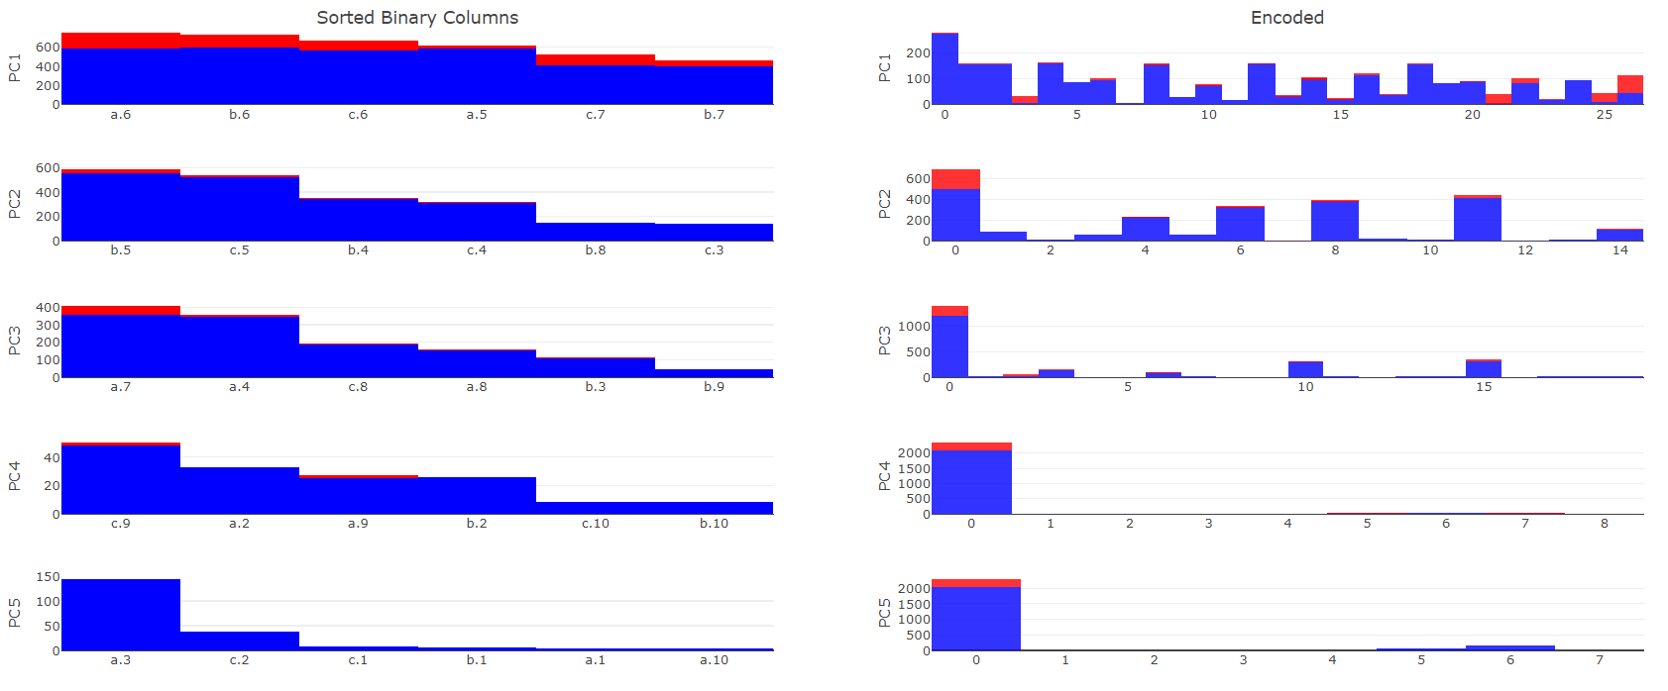
Simulated data - seq. by sum
Sequence by column sum | BCD
Notes:
These is a demonstration of PCA grouping before sequenced by column sum.
in each PC we can see columns from different axis, and also, compare PC1 to PC5, PC5 only has small size binary features. Meaning binary features in PC1 has more samples can explain more variance to the whole data.
The BCD result is reasonable too, the informative seems dwindling by PCs.

Slide 23
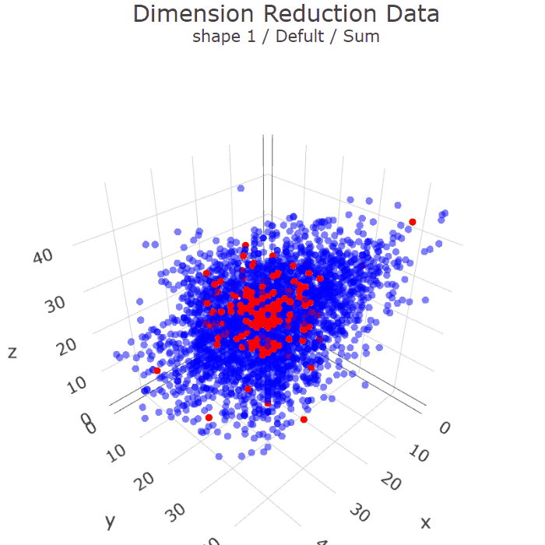
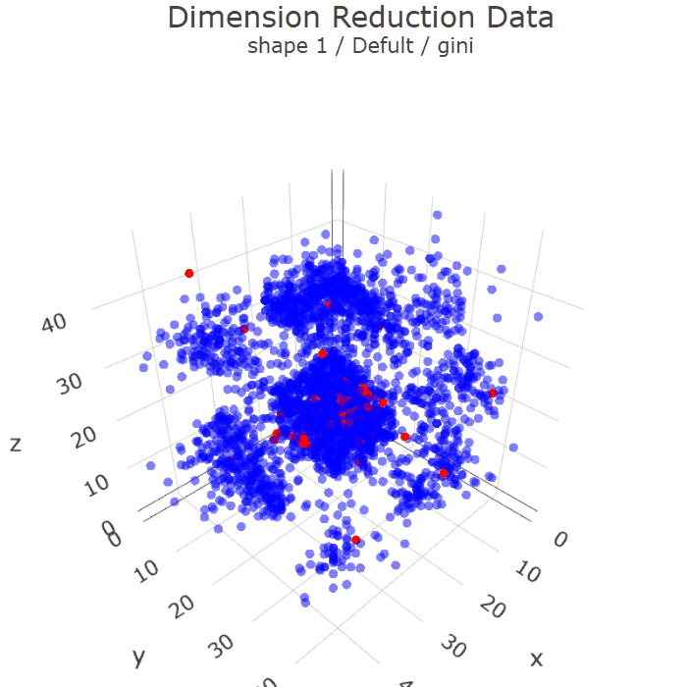
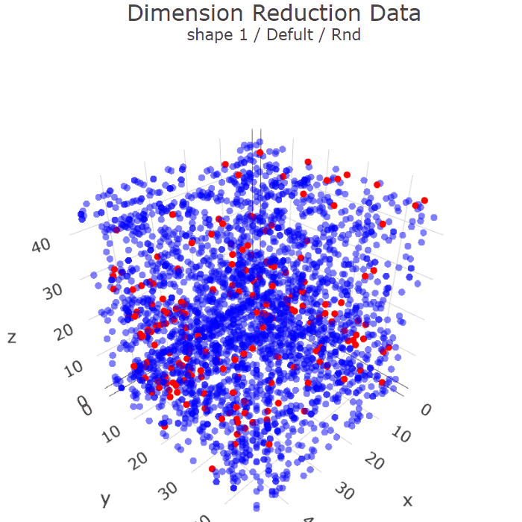
Simulated data - Dimension reduction
Sum | Impurity | RND
Notes:
The method we develop can also use as a way of dimension reduction, visualize the binary data in to the dimension we wanted to.
We can also see a huge difference of sequencing.
It’s not hard to image what kind of data will be benefit whiling training the classification model.

Slide 24
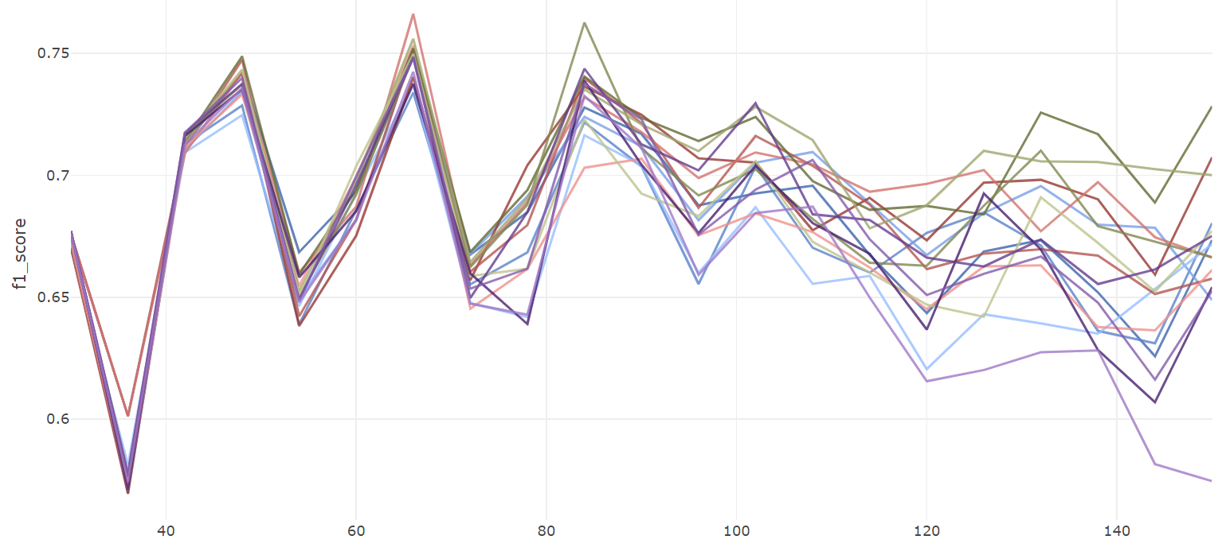
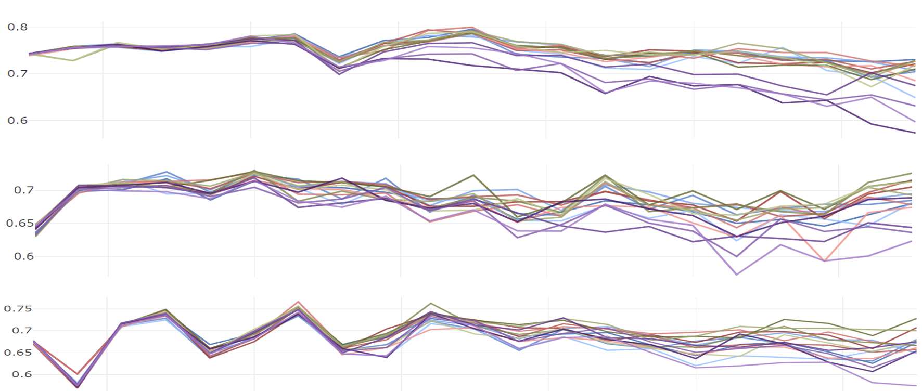
Continuous data - Classification
Dataset 1
Traditional | OneHot
 | Ordinal
 | Target
 | Binary
Default | Sum
 | Purity
 | FI
 | RND
Correlation | Sum
 | Purity
 | FI
 | RND
PCA | Sum
 | Purity
 | FI
 | RND
40 | 60 | 80 | 100 | 120 | 140
Binary Features
Notes:
The line chart shows the k-folds validation average f1 score under different binary features we binarize. We can observe the variance of score became wider as the binary features increase.

Slide 25
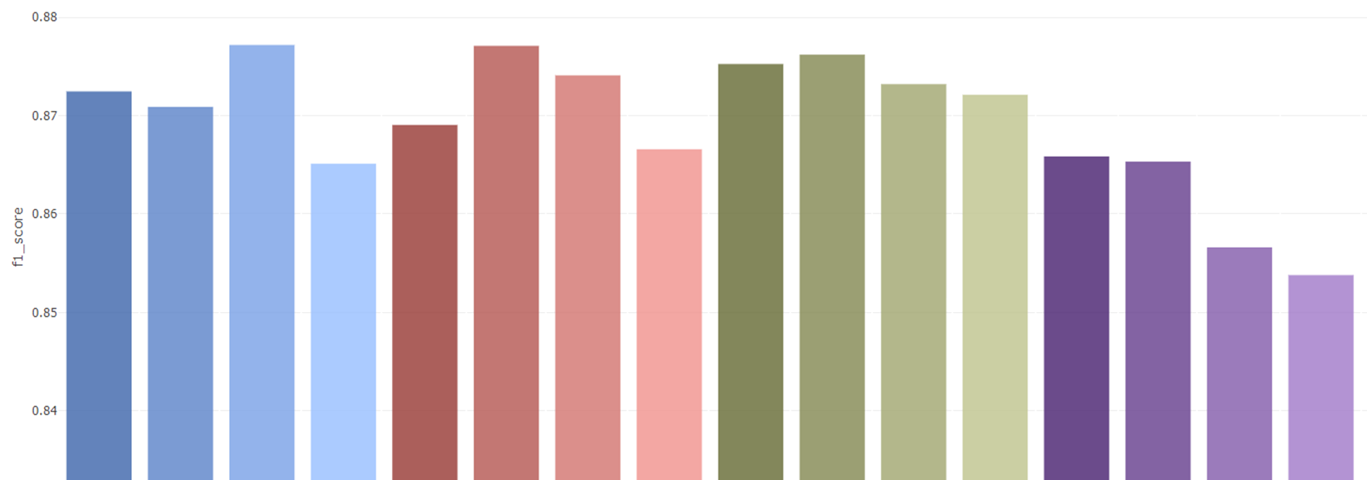
Simulated data - Classification
Dataset 1
 | OneHot | Binary | Target | Ordinal | Sum | Purity | FI | RND | Sum | Purity | FI | RND | Sum | Purity | FI | RND
 | Traditional encoding methods |  |  |  | Default |  |  |  | Correlation |  |  |  | PCA
 | ～ | ～ | 3 |  |  |  |  |  | 5
Notes:
Bar chart shows the average f1 score of the previous line chart. We can see the score of sequenced by impurity and the feature importance is much higher than the random in all groups, and even or above the most variable encoding method under certain combination. Our conclusion here is different grouping and sequencing will definitely effect on classification result.
The numbers below show the data’s number of features. number of features of One hot and binary encoding variate with how we binarize the continuous data.

Slide 26

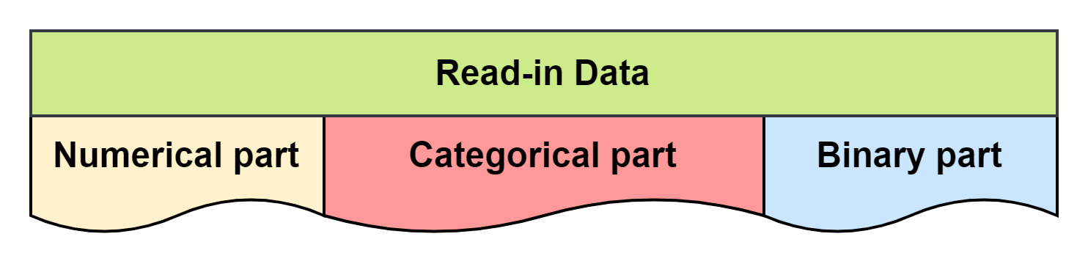
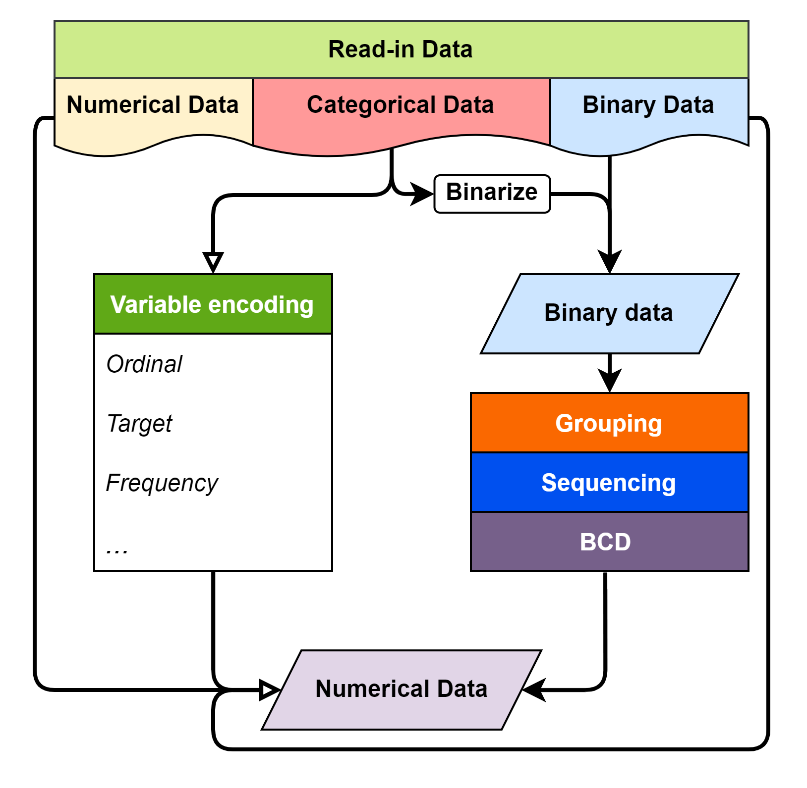
Kaggle dataset
3
9
5
One Hot
75
Notes:
In the Kaggle dataset. We selected some of features as the read-in data. And it contains multiple data types, includes numerical, categorical, and binary. After one hot encoded, it will generate 75 dummy features.

Slide 27
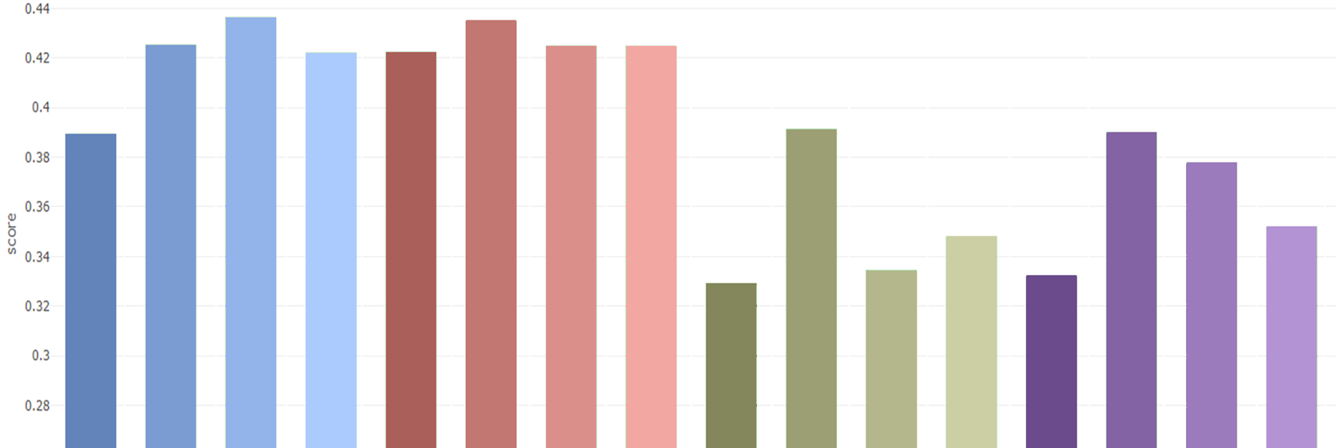
Kaggle dataset - Classification
Feature Encode Challenge
 | OneHot | Binary | Target | Ordinal | Sum | Purity | FI | RND | Sum | Purity | FI | RND | Sum | Purity | FI | RND
 | Traditional encoding methods |  |  |  | Default |  |  |  | Correlation |  |  |  | PCA
 | 83 | 38 | 18 |  |  |  |  |  | 5
Notes:
Although two the grouping method cannot outperform the default group or some traditional encoding methods,

Slide 28
Kaggle dataset - Classification
Feature Encode Challenge
 | OneHot | Binary | Target | Ordinal | Sum | Purity | FI | RND | Sum | Purity | FI | RND | Sum | Purity | FI | RND
 | Traditional encoding methods |  |  |  | Default |  |  |  | Correlation |  |  |  | PCA
 | 83 | 38 | 18 |  |  |  |  |  | 5
Notes:
But, in facing non-grouped binary data, those method can’t be used anymore. And there we can see the advantage. By compress the 83 binary features into 5 numerical, and maintain a same or slightly better classification result.

Slide 29
Conclusion
In this research, we develop a method to encode binary feature data into numerical data, which can compress the binary features information to reduce dimension while remaining a certain level in ML model classification performance. The main advantage of this method compare to traditional encoding methods are:
Encoding Binary features without group knowledge to numerical data.
Adjust the number of features of encoded numerical data.
Remain ML model performance with certain sequencing method.
Notes:
In conclusion, we formulate a way to encode non-grouped binary data into numerical, and can preserve the classification result with certain sequencing method. Or the method can be used as a dimension reduction method for binary data.
That’s all, thank you.

Slide 30

Overview
Motivation
Introduction
Methodology
Case study
Conclusion
Notes:
Not needed

Slide 31
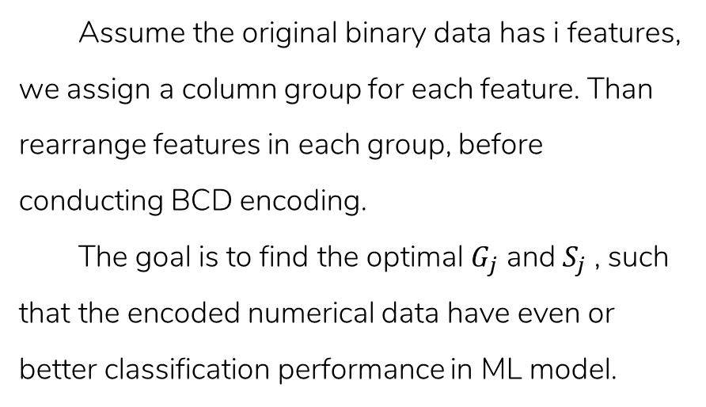
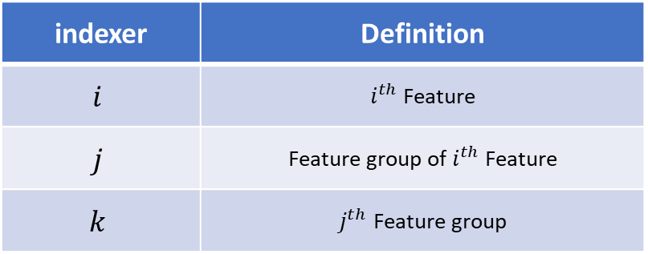
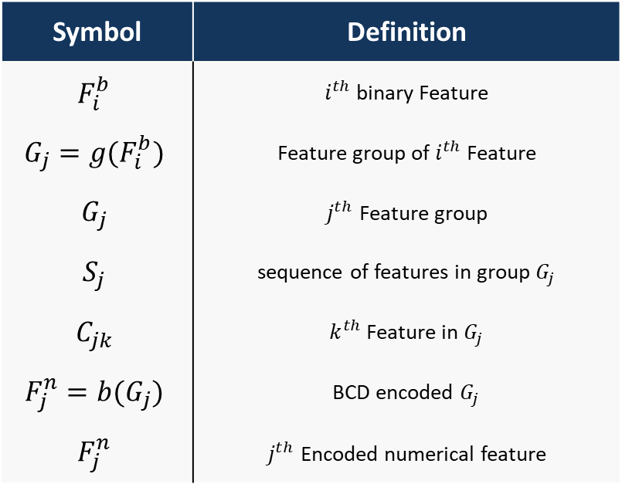
Introduction - cont.
Assume the original binary data has i features, we assign a column group for each feature. Than rearrange features in each group, before conducting BCD encoding.
The goal is to find the optimal $G_{j}$ and $S_{j}$ , such that the encoded numerical data have even or better classification performance in ML model.
Symbol | Definition
$$F_{i}^{b}$$ | $i^{th}$ binary Feature
$$G_{j}=g(F_{i}^{b})$$ | Feature group of $i^{th}$ Feature
$$G_{j}$$ | $j^{th}$ Feature group
$$S_{j}$$ | sequence of features in group $G_{j}$
$$C_{jk}$$ | $k^{th}$ Feature in $G_{j}$
$$F_{j}^{n}=b(G_{j})$$ | BCD encoded $G_{j}$
$$F_{j}^{n}$$ | $j^{th}$ Encoded numerical feature
indexer | Definition
$$i$$ | $i^{th}$ Feature
$$j$$ | Feature group of $i^{th}$ Feature
$$k$$ | $j^{th}$ Feature group
Notes:
可以先不要

Slide 32
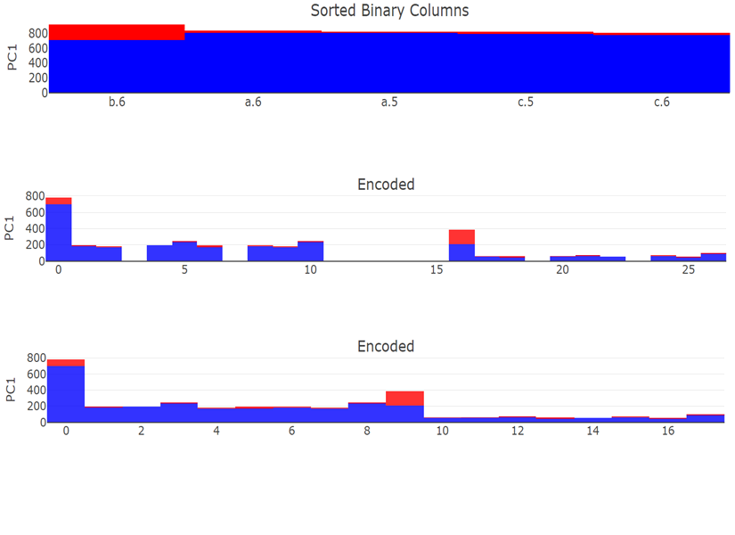
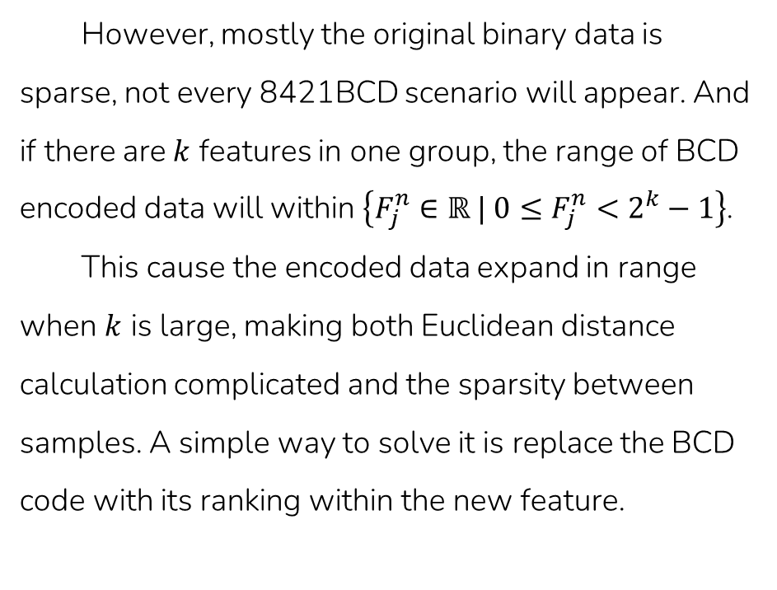
Methodology - BCD encode
However, mostly the original binary data is sparse, not every 8421BCD scenario will appear. And if there are $k$ features in one group, the range of BCD encoded data will within $\left\{F_{j}^{n}∈ℝ | 0≤F_{j}^{n}<2^{k}−1\right\}$.
This cause the encoded data expand in range when $k$ is large, making both Euclidean distance calculation complicated and the sparsity between samples. A simple way to solve it is replace the BCD code with its ranking within the new feature.
Sorted
BCD
Ranked
Notes:
別別別

Slide 33
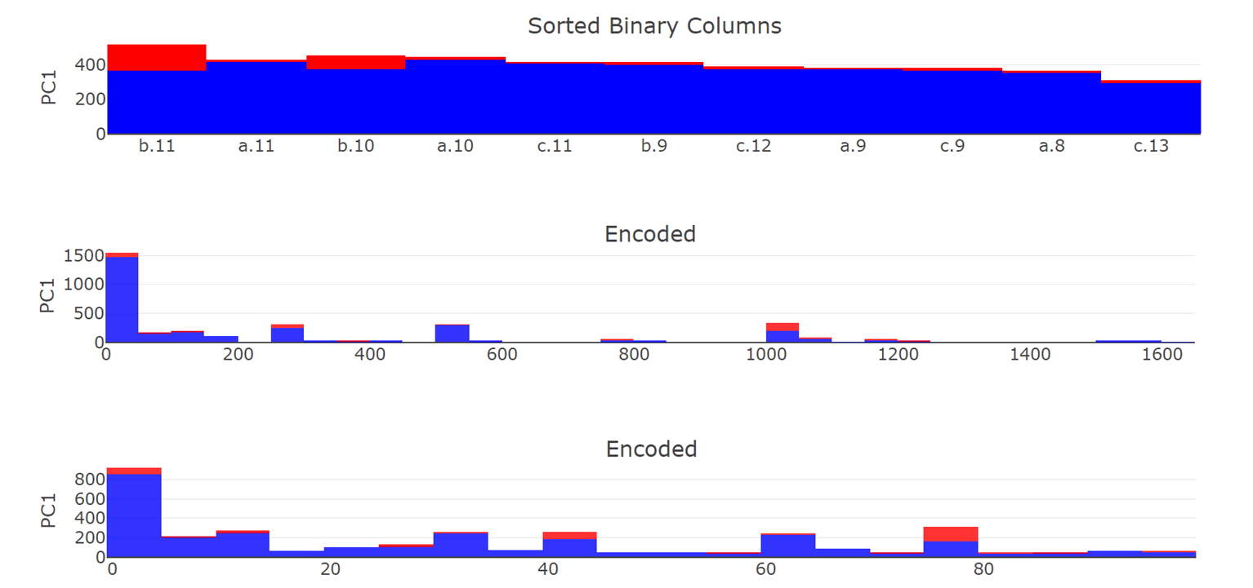
Methodology - BCD encode
Sorted
BCD
Ranked

Slide 34
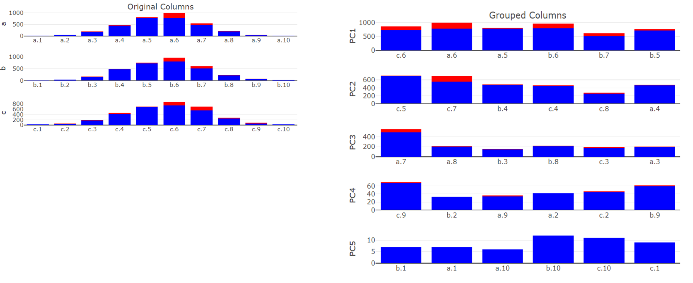
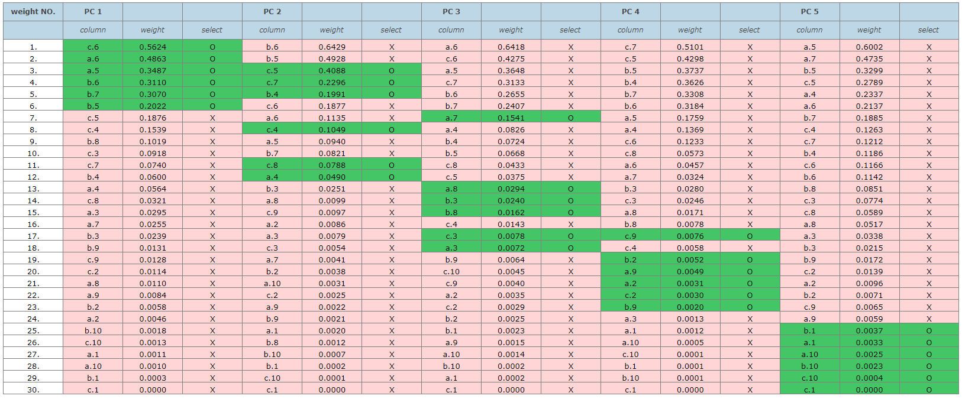
Simulated data - group by PCA
Binarize Data | Grouped by PCA

Slide 35
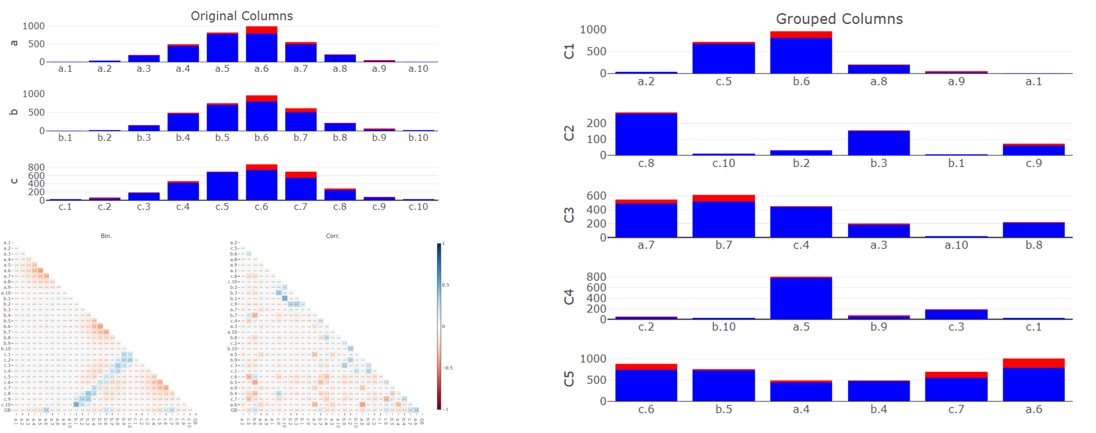
Continuous data - group by Corr.
Original Group | Grouped by Correlation

Slide 36
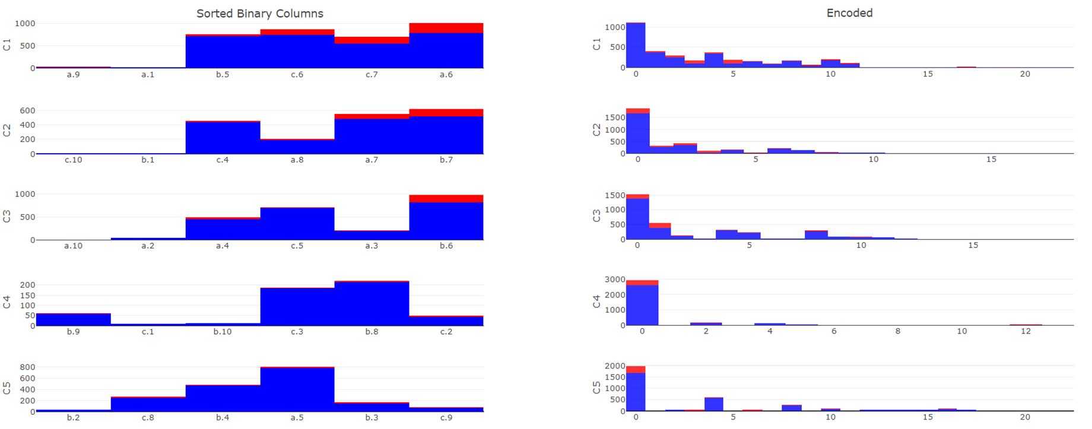
Simulated data - seq. by impurity
Sequence by impurity | BCD encoded

Slide 37
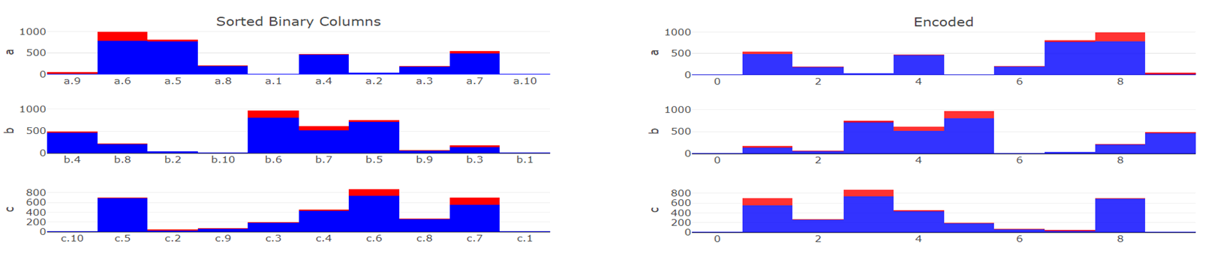
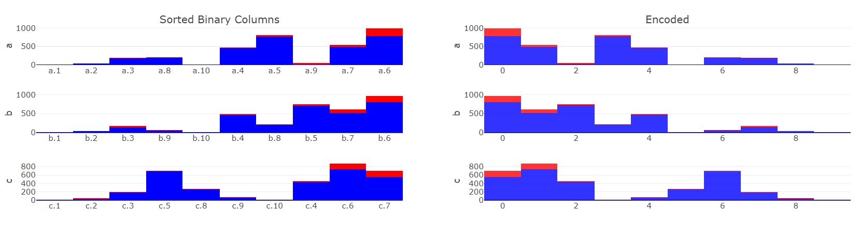
Simulated data - seq. comparison
 | Sequenced | BCD
Randomly
By Impurity

Slide 38
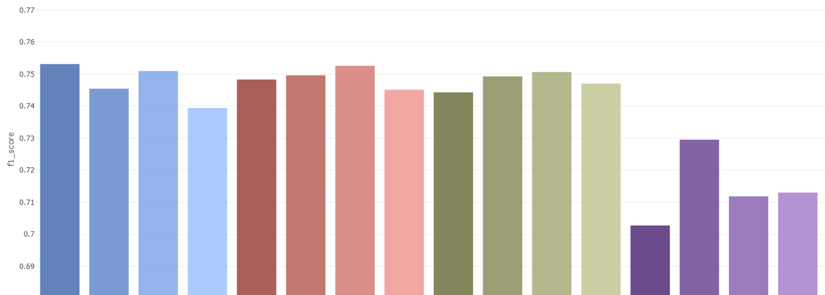
Simulated data - Classification
Shape 1
 | OneHot | Ordinal | Target | Binary | Sum | Purity | FI | RND | Sum | Purity | FI | RND | Sum | Purity | FI | RND
 | Traditional encoding methods |  |  |  | Default |  |  |  | Correlation |  |  |  | PCA

Slide 39
Simulated data - Classification
Shape 3
 | OneHot | Ordinal | Target | Binary | Sum | Purity | FI | RND | Sum | Purity | FI | RND | Sum | Purity | FI | RND
 | Traditional encoding methods |  |  |  | Default |  |  |  | Correlation |  |  |  | PCA

Slide 40
Animal |  |  |  |  |  |  |  | Size |  |  |  | Color
Tuna | Cat | Frog | Cod | Goat | Dog | Toad | Cow | Large | Mid | Small | Tiny | White | Black | Red | Blue | Green | Gray
0 | 0 | 0 | 0 | 0 | 0 | 0 | 1 | 1 | 0 | 0 | 0 | 1 | 0 | 0 | 0 | 0 | 0
1 | 0 | 0 | 0 | 0 | 0 | 0 | 0 | 0 | 1 | 0 | 0 | 0 | 1 | 0 | 0 | 0 | 0
⁝ | ⁝ | ⁝ | ⁝ | ⁝ | ⁝ | ⁝ | ⁝ | ⁝ | ⁝ | ⁝ | ⁝ | ⁝ | ⁝ | ⁝ | ⁝ | ⁝ | ⁝
0 | 0 | 1 | 0 | 0 | 0 | 0 | 1 | 0 | 0 | 0 | 1 | 0 | 0 | 0 | 0 | 1 | 0
No. | PC 1 |  |  | PC 2 |  |  | PC 3
 | Feature | Abs. weight | select | Feature | Abs. weight | select | Feature | Abs. weight | select
1. | Cow | 0.562 | O | Cat | 0.642 | X | Black | 0.047 | X
2. | Cat | 0.486 | O | Cow | 0.496 | X | Goat | 0.035 | X
3. | Large | 0.348 | O | Mid | 0.402 | X | Cat | 0.032 | X
4. | Mid | 0.311 | O | Black | 0.351 | X | Cow | 0.030 | X
5. | White | 0.307 | O | Goat | 0.302 | O | Mid | 0.028 | X
6. | Black | 0.202 | O | Dog | 0.229 | O | Gray | 0.023 | X
7. | Small | 0.187 | X | Large | 0.199 | X | White | 0.021 | X
8. | Goat | 0.153 | X | Frog | 0.183 | O | Dog | 0.020 | X
9. | Cod | 0.101 | X | Small | 0.152 | O | Large | 0.018 | X
10. | Tuna | 0.091 | X | Gray | 0.132 | O | Frog | 0.016 | X
11. | Dog | 0.074 | X | White | 0.105 | X | Small | 0.014 | X
12. | Gray | 0.060 | X | Red | 0.008 | O | Toad | 0.014 | O
13. | Frog | 0.056 | X | Frog | 0.008 | X | Tuna | 0.012 | O
14. | Toad | 0.032 | X | Red | 0.007 | X | Cod | 0.007 | O
15. | Red | 0.029 | X | Toad | 0.005 | X | Red | 0.005 | X
16. | Tiny | 0.023 | X | Green | 0.001 | X | Tiny | 0.002 | O
17. | Green | 0.015 | X | Tiny | 0.001 | X | Blue | 0.001 | O
18. | Blue | 0.009 | X | Blue | 0.001 | X | Green | 0.001 | O
PC 1 |  |  |  |  |  | PC 2 |  |  |  |  |  | PC 3
Cow | Cat | Large | Mid | White | Black | Goat | Dog | Frog | Small | Gray | Red | Toad | Tuna | Cod | Tiny | Blue | Green
1 | 0 | 1 | 0 | 1 | 0 | 0 | 0 | 0 | 0 | 0 | 0 | 0 | 0 | 0 | 0 | 0 | 0
0 | 0 | 0 | 1 | 0 | 1 | 0 | 0 | 0 | 0 | 0 | 0 | 0 | 1 | 0 | 0 | 0 | 0
⁝ | ⁝ | ⁝ | ⁝ | ⁝ | ⁝ | ⁝ | ⁝ | ⁝ | ⁝ | ⁝ | ⁝ | ⁝ | ⁝ | ⁝ | ⁝ | ⁝ | ⁝
1 | 0 | 0 | 0 | 0 | 0 | 0 | 0 | 1 | 0 | 0 | 0 | 0 | 0 | 0 | 1 | 0 | 1
Tuna | Cat | Frog | Cod | Goat | Dog | Toad | Cow | Large | Mid | Small | Tiny | White | Black | Red | Blue | Green | Gray
0 | 0 | 0 | 0 | 0 | 0 | 0 | 1 | 1 | 0 | 0 | 0 | 1 | 0 | 0 | 0 | 0 | 0
1 | 0 | 0 | 0 | 0 | 0 | 0 | 0 | 0 | 1 | 0 | 0 | 0 | 1 | 0 | 0 | 0 | 0
⁝ | ⁝ | ⁝ | ⁝ | ⁝ | ⁝ | ⁝ | ⁝ | ⁝ | ⁝ | ⁝ | ⁝ | ⁝ | ⁝ | ⁝ | ⁝ | ⁝ | ⁝
0 | 0 | 1 | 0 | 0 | 0 | 0 | 1 | 0 | 0 | 0 | 1 | 0 | 0 | 0 | 0 | 1 | 0

Slide 41
Corr 1 |  |  |  |  |  | Corr 2 |  |  |  |  |  | Corr 3
Cow | Cat | Large | Mid | White | Black | Goat | Dog | Frog | Small | Gray | Red | Toad | Tuna | Cod | Tiny | Blue | Green
1 | 0 | 1 | 0 | 1 | 0 | 0 | 0 | 0 | 0 | 0 | 0 | 0 | 0 | 0 | 0 | 0 | 0
0 | 0 | 0 | 1 | 0 | 1 | 0 | 0 | 0 | 0 | 0 | 0 | 0 | 1 | 0 | 0 | 0 | 0
⁝ | ⁝ | ⁝ | ⁝ | ⁝ | ⁝ | ⁝ | ⁝ | ⁝ | ⁝ | ⁝ | ⁝ | ⁝ | ⁝ | ⁝ | ⁝ | ⁝ | ⁝
1 | 0 | 0 | 0 | 0 | 0 | 0 | 0 | 1 | 0 | 0 | 0 | 0 | 0 | 0 | 1 | 0 | 1
 | Tuna | Cat | Frog | Cod | Goat | Dog | Toad | Cow | Large | Mid | Small | Tiny | White | Black | Red | Blue | Green | Gray
Tuna | 1.0 | 0.2 | 0.2 | 0.8 | 0.2 | 0.2 | 0.8 | 0.2 | 0.1 | 0.1 | 0.1 | 0.3 | 0.0 | 0.0 | 0.0 | 0.5 | 0.5 | 0.0
Cat | 0.2 | 1.0 | 0.2 | 0.2 | 0.2 | 0.2 | 0.2 | 0.8 | 0.3 | 0.3 | 0.1 | 0.1 | 0.2 | 0.2 | 0.0 | 0.0 | 0.0 | 0.0
Frog | 0.2 | 0.2 | 1.0 | 0.2 | 0.8 | 0.8 | 0.2 | 0.2 | 0.1 | 0.1 | 0.3 | 0.1 | 0.0 | 0.0 | 0.3 | 0.0 | 0.0 | 0.3
Cod | 0.8 | 0.2 | 0.2 | 1.0 | 0.2 | 0.2 | 0.8 | 0.8 | 0.1 | 0.1 | 0.1 | 0.3 | 0.0 | 0.0 | 0.0 | 0.3 | 0.3 | 0.0
Goat | 0.2 | 0.2 | 0.8 | 0.2 | 1.0 | 0.8 | 0.2 | 0.2 | 0.1 | 0.1 | 0.3 | 0.1 | 0.0 | 0.0 | 0.3 | 0.0 | 0.0 | 0.3
Dog | 0.2 | 0.2 | 0.8 | 0.2 | 0.8 | 1.0 | 0.2 | 0.2 | 0.1 | 0.1 | 0.3 | 0.1 | 0.0 | 0.0 | 0.3 | 0.0 | 0.0 | 0.3
Toad | 0.8 | 0.2 | 0.2 | 0.8 | 0.2 | 0.2 | 1.0 | 0.2 | 0.1 | 0.1 | 0.1 | 0.3 | 0.0 | 0.0 | 0.0 | 0.3 | 0.0 | 0.0
Cow | 0.2 | 0.8 | 0.2 | 0.8 | 0.2 | 0.2 | 0.2 | 1.0 | 0.3 | 0.3 | 0.1 | 0.1 | 0.3 | 0.3 | 0.0 | 0.0 | 0.0 | 0.0
Large | 0.1 | 0.3 | 0.1 | 0.1 | 0.1 | 0.1 | 0.1 | 0.3 | 1.0 | 0.5 | 0.1 | 0.1 | 0.6 | 0.6 | 0.2 | 0.2 | 0.2 | 0.2
Mid | 0.1 | 0.3 | 0.1 | 0.1 | 0.1 | 0.1 | 0.1 | 0.3 | 0.5 | 1.0 | 0.1 | 0.1 | 0.6 | 0.6 | 0.2 | 0.2 | 0.2 | 0.2
Small | 0.1 | 0.1 | 0.3 | 0.1 | 0.3 | 0.3 | 0.1 | 0.1 | 0.1 | 0.1 | 1.0 | 0.1 | 0.2 | 0.2 | 0.6 | 0.2 | 0.2 | 0.6
Tiny | 0.3 | 0.1 | 0.1 | 0.3 | 0.1 | 0.1 | 0.3 | 0.1 | 0.1 | 0.1 | 0.1 | 1.0 | 0.2 | 0.2 | 0.2 | 0.6 | 0.2 | 0.2
White | 0.0 | 0.2 | 0.0 | 0.0 | 0.0 | 0.0 | 0.0 | 0.3 | 0.6 | 0.6 | 0.2 | 0.2 | 1.0 | 0.8 | 0.4 | 0.4 | 0.4 | 0.4
Black | 0.0 | 0.2 | 0.0 | 0.0 | 0.0 | 0.0 | 0.0 | 0.3 | 0.6 | 0.6 | 0.2 | 0.2 | 0.8 | 1.0 | 0.4 | 0.4 | 0.4 | 0.8
Red | 0.0 | 0.0 | 0.3 | 0.0 | 0.3 | 0.3 | 0.0 | 0.0 | 0.2 | 0.2 | 0.6 | 0.2 | 0.4 | 0.4 | 1.0 | 0.4 | 0.4 | 0.4
Blue | 0.5 | 0.0 | 0.0 | 0.3 | 0.0 | 0.0 | 0.3 | 0.0 | 0.2 | 0.2 | 0.2 | 0.6 | 0.4 | 0.4 | 0.4 | 1.0 | 0.8 | 0.8
Green | 0.5 | 0.0 | 0.0 | 0.3 | 0.0 | 0.0 | 0.0 | 0.0 | 0.2 | 0.2 | 0.2 | 0.2 | 0.4 | 0.4 | 0.4 | 0.8 | 1.0 | 0.4
Gray | 0.0 | 0.0 | 0.3 | 0.0 | 0.3 | 0.3 | 0.0 | 0.0 | 0.2 | 0.2 | 0.6 | 0.2 | 0.4 | 0.8 | 0.4 | 0.8 | 0.4 | 1.0
 | Cow | Cat | Large | Mid | White | Black | Goat | Dog | Frog | Small | Gray | Red | Toad | Tuna | Cod | Tiny | Blue | Green
Cow | 1.0 | 0.8 | 0.3 | 0.3 | 0.5 | 0.5 | 0.2 | 0.2 | 0.2 | 0.1 | 0.0 | 0.0 | 0.2 | 0.2 | 0.2 | 0.1 | 0.0 | 0.0
Cat | 0.8 | 1.0 | 0.3 | 0.3 | 0.5 | 0.5 | 0.2 | 0.2 | 0.2 | 0.1 | 0.0 | 0.0 | 0.2 | 0.2 | 0.2 | 0.1 | 0.0 | 0.0
Large | 0.3 | 0.3 | 1.0 | 0.5 | 0.6 | 0.6 | 0.1 | 0.1 | 0.1 | 0.1 | 0.2 | 0.2 | 0.1 | 0.1 | 0.1 | 0.1 | 0.2 | 0.2
Mid | 0.3 | 0.3 | 0.5 | 1.0 | 0.6 | 0.6 | 0.1 | 0.1 | 0.1 | 0.1 | 0.2 | 0.2 | 0.1 | 0.1 | 0.1 | 0.1 | 0.2 | 0.2
White | 0.5 | 0.5 | 0.6 | 0.6 | 1.0 | 0.8 | 0.0 | 0.0 | 0.0 | 0.2 | 0.4 | 0.4 | 0.0 | 0.0 | 0.0 | 0.2 | 0.4 | 0.4
Black | 0.5 | 0.5 | 0.6 | 0.6 | 0.8 | 1.0 | 0.0 | 0.0 | 0.0 | 0.2 | 0.4 | 0.4 | 0.0 | 0.0 | 0.0 | 0.2 | 0.4 | 0.4
Goat | 0.2 | 0.2 | 0.1 | 0.1 | 0.0 | 0.0 | 1.0 | 0.8 | 0.8 | 0.3 | 0.3 | 0.3 | 0.2 | 0.2 | 0.2 | 0.1 | 0.0 | 0.0
Dog | 0.2 | 0.2 | 0.1 | 0.1 | 0.0 | 0.0 | 0.8 | 1.0 | 0.8 | 0.3 | 0.5 | 0.5 | 0.2 | 0.2 | 0.2 | 0.1 | 0.0 | 0.0
Frog | 0.2 | 0.2 | 0.1 | 0.1 | 0.0 | 0.0 | 0.8 | 0.8 | 1.0 | 0.3 | 0.5 | 0.5 | 0.2 | 0.2 | 0.2 | 0.1 | 0.0 | 0.0
Small | 0.1 | 0.1 | 0.1 | 0.1 | 0.2 | 0.2 | 0.3 | 0.3 | 0.3 | 1.0 | 0.6 | 0.6 | 0.1 | 0.1 | 0.1 | 0.1 | 0.2 | 0.2
Gray | 0.0 | 0.0 | 0.2 | 0.2 | 0.4 | 0.4 | 0.3 | 0.5 | 0.5 | 0.6 | 1.0 | 0.8 | 0.0 | 0.0 | 0.0 | 0.2 | 0.4 | 0.4
Red | 0.0 | 0.0 | 0.2 | 0.2 | 0.4 | 0.4 | 0.3 | 0.5 | 0.5 | 0.6 | 0.8 | 1.0 | 0.0 | 0.0 | 0.0 | 0.2 | 0.4 | 0.4
Toad | 0.2 | 0.2 | 0.1 | 0.1 | 0.0 | 0.0 | 0.2 | 0.2 | 0.2 | 0.1 | 0.0 | 0.0 | 1.0 | 0.8 | 0.8 | 0.3 | 0.5 | 0.5
Tuna | 0.2 | 0.2 | 0.1 | 0.1 | 0.0 | 0.0 | 0.2 | 0.2 | 0.2 | 0.1 | 0.0 | 0.0 | 0.8 | 1.0 | 0.8 | 0.3 | 0.5 | 0.5
Cod | 0.2 | 0.2 | 0.1 | 0.1 | 0.0 | 0.0 | 0.2 | 0.2 | 0.2 | 0.1 | 0.0 | 0.0 | 0.8 | 0.8 | 1.0 | 0.3 | 0.5 | 0.5
Tiny | 0.1 | 0.1 | 0.1 | 0.1 | 0.2 | 0.2 | 0.1 | 0.1 | 0.1 | 0.1 | 0.2 | 0.2 | 0.3 | 0.3 | 0.3 | 1.0 | 0.6 | 0.6
Blue | 0.0 | 0.0 | 0.2 | 0.2 | 0.4 | 0.4 | 0.0 | 0.0 | 0.0 | 0.2 | 0.4 | 0.4 | 0.5 | 0.5 | 0.5 | 0.6 | 1.0 | 0.8
Green | 0.0 | 0.0 | 0.2 | 0.2 | 0.4 | 0.4 | 0.0 | 0.0 | 0.0 | 0.2 | 0.4 | 0.4 | 0.5 | 0.5 | 0.5 | 0.6 | 0.8 | 1.0

Slide 45
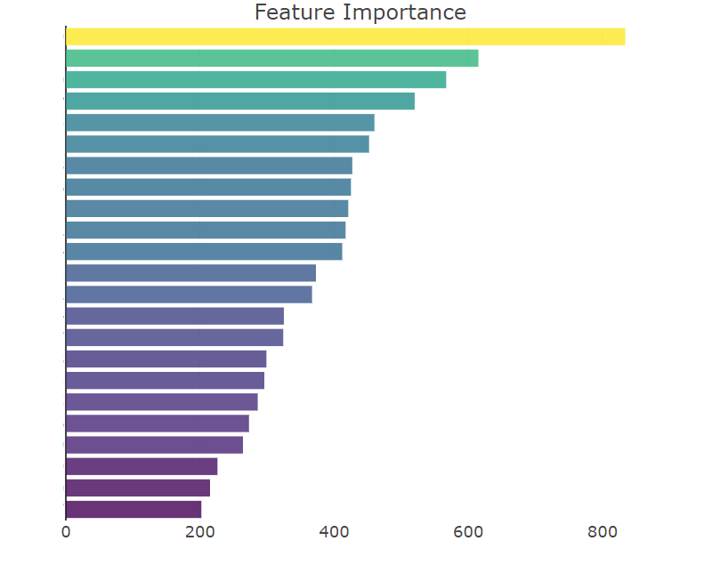

Slide 46
 | Sequenced Column Group |  |  |  |  |  | BCD | Type
 | Blue | Tuna | Tiny | Toad | Green | Cod
Sample 1 | 1 | 0 | 0 | 0 | 0 | 1 | 33 | Good
Sample 2 | 1 | 0 | 0 | 1 | 0 | 0 | 36 | Good
Sample 3 | 0 | 0 | 1 | 0 | 1 | 0 | 10 | Bad
Sample 4 | 0 | 0 | 1 | 1 | 1 | 0 | 14 | Bad
⁝ | ⁝ | ⁝ | ⁝ | ⁝ | ⁝ | ⁝ | ⁝ | ⁝

Slide 47
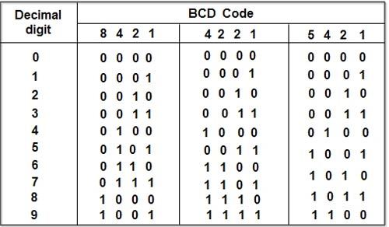
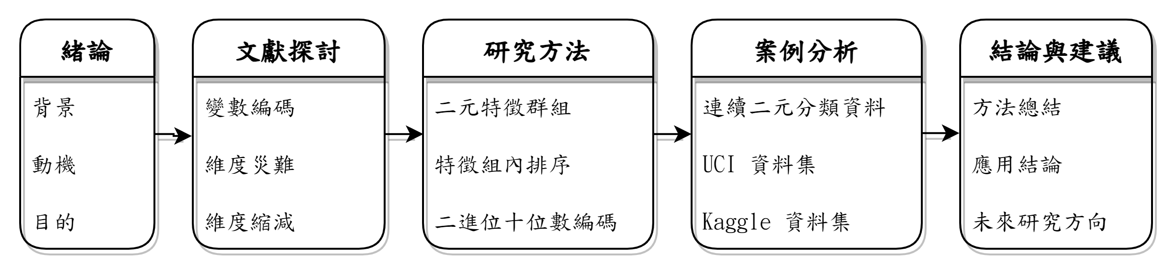
Decimal digit | BCD Code
 | 8421 |  |  |  | 4221 |  |  |  | 5421
0 | 0 | 0 | 0 | 0 | 0 | 0 | 0 | 0 | 0 | 0 | 0 | 0
1 | 0 | 0 | 0 | 1 | 0 | 0 | 0 | 1 | 0 | 0 | 0 | 1
2 | 0 | 0 | 1 | 0 | 0 | 0 | 1 | 0 | 0 | 0 | 1 | 0
3 | 0 | 0 | 1 | 1 | 0 | 0 | 1 | 1 | 0 | 0 | 1 | 1
4 | 0 | 1 | 0 | 0 | 1 | 0 | 0 | 0 | 0 | 1 | 0 | 0
5 | 0 | 1 | 0 | 1 | 0 | 0 | 1 | 1 | 1 | 0 | 0 | 1
6 | 0 | 1 | 1 | 0 | 1 | 1 | 0 | 0 | 1 | 0 | 1 | 0
7 | 0 | 1 | 1 | 1 | 1 | 1 | 0 | 1 | 1 | 0 | 1 | 1
8 | 1 | 0 | 0 | 0 | 1 | 1 | 1 | 0 | 1 | 1 | 0 | 0
UCI 資料集
Kaggle 資料集

Slide 48
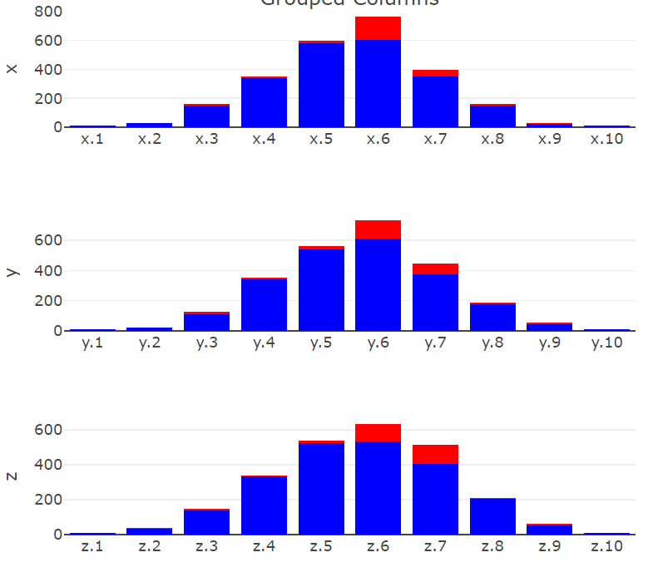
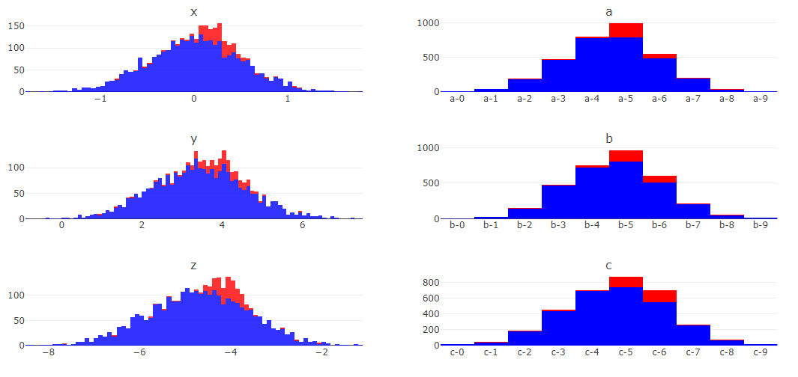
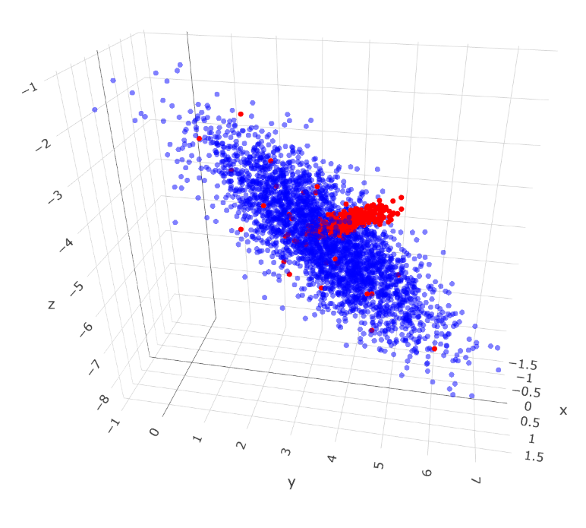
Instances | X | Y | Z
1 | x.2 | y.9 | z.4
2 | x.1 | y.8 | z.2
3 | x.9 | y.1 | z.6
4 | x.5 | y.7 | z.8
5 | x.3 | y.1 | z.8
6 | x.5 | y.6 | z.3
7 | x.7 | y.5 | z.4
⁝ | ⁝ | ⁝ | ⁝
3300 | x.4 | y.8 | z.1
Instances | x.1 | x.2 | x.3 | x.4 | x.5 | x.6 | … | z.9 | z.10
1 | 0 | 1 | 0 | 0 | 0 | 0 | … | 0 | 0
2 | 1 | 0 | 0 | 0 | 0 | 0 | … | 0 | 0
3 | 0 | 0 | 0 | 0 | 0 | 0 | … | 0 | 0
4 | 0 | 0 | 0 | 0 | 1 | 0 | … | 0 | 0
5 | 0 | 0 | 1 | 0 | 0 | 0 | … | 0 | 0
6 | 0 | 0 | 0 | 0 | 1 | 0 | … | 0 | 0
7 | 0 | 0 | 0 | 0 | 0 | 0 | … | 0 | 0
⁝ | ⁝ | ⁝ | ⁝ | ⁝ | ⁝ | ⁝ | ⁝ | ⁝ | ⁝
3300 | 0 | 0 | 0 | 1 | 0 | 0 | … | 0 | 0

Slide 49
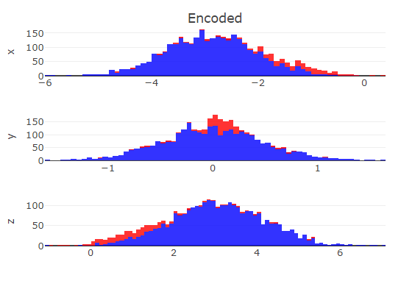
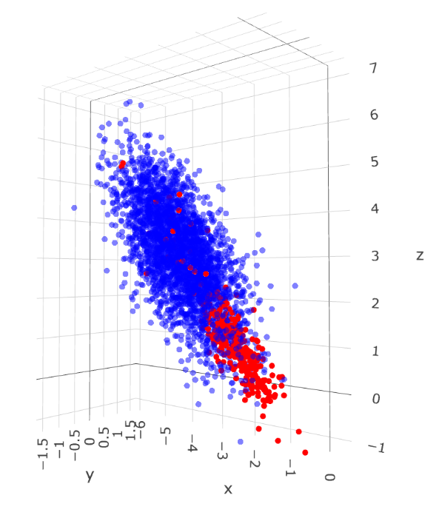
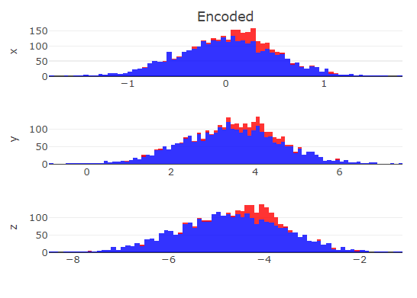
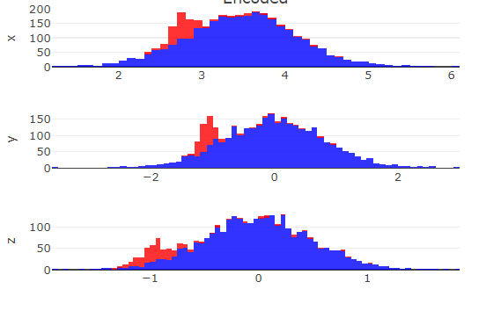
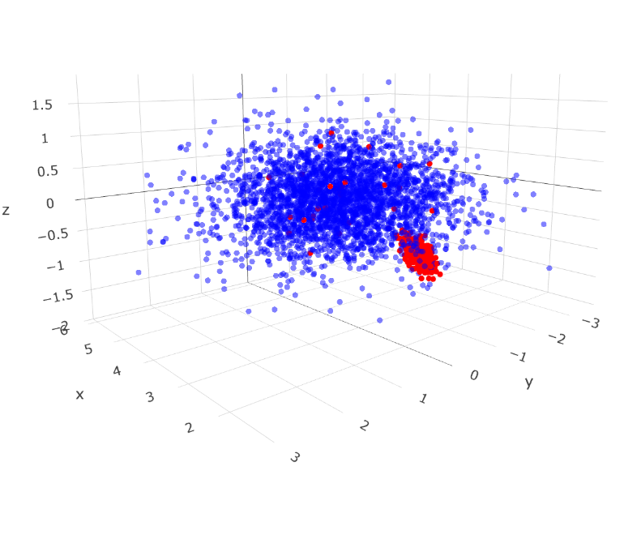
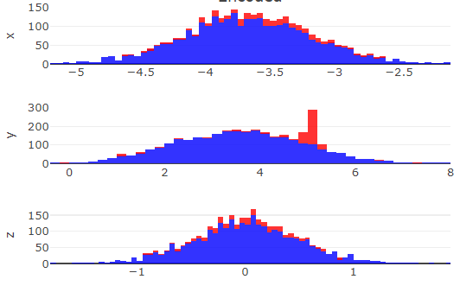


Slide 50
 | One Hot | Binary | Ordinal | Target | Purity | Purity
 | Traditional |  |  |  | Default | PCA
 | 83 | 38 | 17 |  |  | 10 | 20 | 30

Slide 51


To Do
Introduction
Review
Correlation grouping
Method
Dimension reduction part
Case study
Kaggle dataset
UCI dataset
Future work

Slide 52



By purity |  | Randomly
1 | Cluster | 24

Slide 53






Difference 3D Dimension Reduced Data After Encode With Certain Sequencing
Impurity | Randomly | Sum

Slide 54

 |  | True Condition
 | Total Population (T) | Positive | Negative
Prediction | Positive | True Positive (TP) | False Positive (FP) | Positive Predictive Value (PPV), Precision $$\frac{TP}{TP+FP}$$
 | Negative | False Negative (FN) | True Negative (TN) | False Omission Rate (FOR) $$\frac{FN}{FN+TN}$$
 |  | True Positive Rate (TPR), Sensitivity, Recall $$\frac{TP}{TP+FN}$$ | True Negative Rate (TNR), Fall-out $$\frac{FP}{FP+TN}$$

Slide 55


 | One Hot | Binary | Ordinal | Target | Sum | Purity | FI | RND | Sum | Purity | FI | RND | Sum | Purity | FI | RND | Sum | Purity | FI | RND
 | Traditional |  |  |  | Default |  |  |  | Correlation |  |  |  | PCA |  |  |  | RND
 | 21 | 15 | 6

Slide 56


 | One Hot | Binary | Ordinal | Target | Sum | Purity | FI | RND | Sum | Purity | FI | RND | Sum | Purity | FI | RND | Sum | Purity | FI | RND
 | Traditional |  |  |  | Default |  |  |  | Correlation |  |  |  | PCA |  |  |  | RND
 | 85 | 37 | 17
17

Slide 57





 | One Hot | Binary | Ordinal | Target | Sum | Purity | FI | RND | Sum | Purity | FI | RND | Sum | Purity | FI | RND | Sum | Purity | FI | RND
 | Traditional |  |  |  | Default |  |  |  | Correlation |  |  |  | PCA |  |  |  | RND
 | ～ | ～ | 3
 | One Hot | Binary | Ordinal | Target | Sum | Purity | FI | RND | Sum | Purity | FI | RND | Sum | Purity | FI | RND | Sum | Purity | FI | RND
 | Traditional |  |  |  | Default |  |  |  | Correlation |  |  |  | PCA |  |  |  | RND
 | ～ | ～ | 3
 | One Hot | Binary | Ordinal | Target | Sum | Purity | FI | RND | Sum | Purity | FI | RND | Sum | Purity | FI | RND | Sum | Purity | FI | RND
 | Traditional |  |  |  | Default |  |  |  | Correlation |  |  |  | PCA |  |  |  | RND
 | ～ | ～ | 3

Slide 58



 | Purity | Purity | Purity | Purity | Purity
 | PCA
 | 10 | 20 | 30 | 40 | 50
 | Purity | Purity | Purity | Purity | Purity
 | Corr
 | 10 | 20 | 30 | 40 | 50

Slide 59

Feature uniqueness of UCI car evaluation dataset
Price | Maintenance | Doors | Persons | Luggage boot | Safety | Evaluation
vhigh | vhigh | 2 | 2 | small | med | Acceptable
high | high | 3 | 4 | med | high | Unacceptable
med | med | 4 | more | big | low
low | low | 5more
Categorical feature uniqueness of Kaggle CFEC dataset
nom0 | nom1 | nom2 | nom3 | nom4 | ord1 | ord2 | ord3 | ord4
Green | Triangle | Snake | Finland | Bassoon | Grandmaster | Cold | a | A
Blue | Trapezoid | Hamster | Russia | Piano | Expert | Hot | b | B
Red | Polygon | Lion | Canada | Theremin | Novice | Lava Hot | c | C
 | Square | Cat | Costa Rica | Oboe | Contributor | Boiling Hot | d | D
 | Star | Dog | China |  | Master | Freezing | ⁝ | ⁝
 | Circle | Axolotl | India |  |  | Warm | o | Z
Numerical feature uniqueness of Kaggle CFEC dataset
bin0 | bin1 | bin2 | bin3 | bin4 | ord0 | day | month | Target
0 | 0 | 0 | 0 | 0 | 1 | 1 | 1 | 0
1 | 1 | 1 | 1 | 1 | 2 | 2 | 2 | 1
 |  |  |  |  | 3 | 3 | 3
 |  |  |  |  |  | ⁝ | ⁝
 |  |  |  |  |  | 7 | 12

Slide 60



Slide 61
Shape 2
Binary feature | Traditional Encoding |  |  |  | Default |  |  |  | Correlation |  |  |  | PCA |  |  |  | Random
 | One Hot | Binary | Ordinal | Target | Sum | Purity | IMP. | RND | Sum | Purity | IMP. | RND | Sum | Purity | IMP. | RND | Sum | Purity | IMP. | RND
30 | 0.638 | 0.650 | 0.644 | 0.654 | 0.649 | 0.653 | 0.650 | 0.643 | 0.649 | 0.635 | 0.652 | 0.647 | 0.648 | 0.649 | 0.643 | 0.648 | 0.649 | 0.644 | 0.650 | 0.635
33 | 0.718 | 0.715 | 0.722 | 0.724 | 0.723 | 0.718 | 0.716 | 0.720 | 0.722 | 0.721 | 0.724 | 0.717 | 0.726 | 0.721 | 0.727 | 0.722 | 0.723 | 0.728 | 0.720 | 0.722
36 | 0.685 | 0.687 | 0.695 | 0.692 | 0.688 | 0.687 | 0.688 | 0.688 | 0.678 | 0.690 | 0.694 | 0.700 | 0.691 | 0.682 | 0.678 | 0.691 | 0.679 | 0.686 | 0.672 | 0.686
39 | 0.746 | 0.749 | 0.745 | 0.749 | 0.742 | 0.743 | 0.744 | 0.744 | 0.751 | 0.743 | 0.741 | 0.741 | 0.742 | 0.739 | 0.737 | 0.740 | 0.746 | 0.743 | 0.747 | 0.746
42 | 0.715 | 0.728 | 0.729 | 0.737 | 0.719 | 0.729 | 0.727 | 0.716 | 0.715 | 0.715 | 0.723 | 0.727 | 0.719 | 0.729 | 0.719 | 0.722 | 0.721 | 0.719 | 0.713 | 0.712
45 | 0.703 | 0.700 | 0.699 | 0.706 | 0.701 | 0.706 | 0.709 | 0.701 | 0.694 | 0.689 | 0.696 | 0.704 | 0.700 | 0.680 | 0.687 | 0.706 | 0.698 | 0.699 | 0.698 | 0.703
48 | 0.727 | 0.716 | 0.745 | 0.726 | 0.733 | 0.735 | 0.714 | 0.722 | 0.722 | 0.721 | 0.748 | 0.732 | 0.721 | 0.713 | 0.717 | 0.720 | 0.728 | 0.704 | 0.705 | 0.713
51 | 0.726 | 0.714 | 0.735 | 0.723 | 0.728 | 0.725 | 0.730 | 0.735 | 0.733 | 0.728 | 0.732 | 0.728 | 0.712 | 0.702 | 0.720 | 0.708 | 0.735 | 0.727 | 0.730 | 0.719
54 | 0.705 | 0.697 | 0.704 | 0.713 | 0.698 | 0.712 | 0.696 | 0.704 | 0.734 | 0.709 | 0.709 | 0.719 | 0.716 | 0.680 | 0.691 | 0.701 | 0.699 | 0.700 | 0.694 | 0.676
57 | 0.745 | 0.738 | 0.742 | 0.756 | 0.740 | 0.746 | 0.734 | 0.739 | 0.754 | 0.745 | 0.735 | 0.741 | 0.747 | 0.732 | 0.742 | 0.730 | 0.742 | 0.735 | 0.730 | 0.732
60 | 0.699 | 0.715 | 0.716 | 0.725 | 0.726 | 0.715 | 0.707 | 0.714 | 0.712 | 0.732 | 0.713 | 0.724 | 0.713 | 0.702 | 0.683 | 0.706 | 0.712 | 0.693 | 0.691 | 0.699
63 | 0.681 | 0.709 | 0.706 | 0.708 | 0.705 | 0.710 | 0.695 | 0.698 | 0.712 | 0.701 | 0.688 | 0.677 | 0.689 | 0.686 | 0.676 | 0.661 | 0.686 | 0.693 | 0.669 | 0.694
66 | 0.688 | 0.700 | 0.698 | 0.717 | 0.709 | 0.711 | 0.703 | 0.697 | 0.707 | 0.716 | 0.689 | 0.677 | 0.695 | 0.697 | 0.664 | 0.655 | 0.671 | 0.659 | 0.667 | 0.655
69 | 0.662 | 0.671 | 0.679 | 0.697 | 0.679 | 0.696 | 0.667 | 0.664 | 0.708 | 0.656 | 0.689 | 0.700 | 0.693 | 0.659 | 0.653 | 0.654 | 0.688 | 0.659 | 0.659 | 0.654
72 | 0.719 | 0.710 | 0.727 | 0.729 | 0.732 | 0.741 | 0.729 | 0.716 | 0.738 | 0.731 | 0.720 | 0.729 | 0.723 | 0.682 | 0.689 | 0.675 | 0.708 | 0.693 | 0.712 | 0.681
75 | 0.676 | 0.676 | 0.684 | 0.698 | 0.664 | 0.676 | 0.682 | 0.673 | 0.674 | 0.697 | 0.695 | 0.709 | 0.703 | 0.657 | 0.638 | 0.645 | 0.672 | 0.651 | 0.672 | 0.659
78 | 0.696 | 0.711 | 0.715 | 0.720 | 0.708 | 0.699 | 0.700 | 0.711 | 0.709 | 0.689 | 0.715 | 0.702 | 0.711 | 0.668 | 0.662 | 0.648 | 0.694 | 0.678 | 0.679 | 0.684
81 | 0.716 | 0.717 | 0.720 | 0.725 | 0.708 | 0.717 | 0.705 | 0.719 | 0.732 | 0.691 | 0.696 | 0.724 | 0.714 | 0.669 | 0.692 | 0.672 | 0.719 | 0.703 | 0.693 | 0.704
84 | 0.713 | 0.716 | 0.724 | 0.706 | 0.704 | 0.705 | 0.703 | 0.675 | 0.709 | 0.689 | 0.679 | 0.667 | 0.674 | 0.660 | 0.667 | 0.647 | 0.692 | 0.649 | 0.663 | 0.684
87 | 0.637 | 0.652 | 0.662 | 0.670 | 0.655 | 0.655 | 0.650 | 0.644 | 0.665 | 0.660 | 0.649 | 0.636 | 0.643 | 0.608 | 0.596 | 0.615 | 0.628 | 0.609 | 0.619 | 0.608
90 | 0.669 | 0.654 | 0.656 | 0.679 | 0.667 | 0.669 | 0.644 | 0.653 | 0.686 | 0.670 | 0.645 | 0.664 | 0.673 | 0.643 | 0.650 | 0.619 | 0.668 | 0.648 | 0.621 | 0.615
93 | 0.660 | 0.673 | 0.676 | 0.679 | 0.683 | 0.699 | 0.686 | 0.681 | 0.698 | 0.692 | 0.676 | 0.673 | 0.697 | 0.618 | 0.638 | 0.640 | 0.683 | 0.663 | 0.630 | 0.635
96 | 0.655 | 0.648 | 0.657 | 0.672 | 0.687 | 0.697 | 0.678 | 0.669 | 0.682 | 0.685 | 0.679 | 0.663 | 0.670 | 0.622 | 0.595 | 0.616 | 0.643 | 0.654 | 0.631 | 0.638
99 | 0.654 | 0.673 | 0.684 | 0.685 | 0.691 | 0.676 | 0.690 | 0.663 | 0.705 | 0.676 | 0.692 | 0.684 | 0.693 | 0.648 | 0.615 | 0.612 | 0.690 | 0.668 | 0.646 | 0.619
102 | 0.684 | 0.692 | 0.694 | 0.700 | 0.704 | 0.696 | 0.688 | 0.689 | 0.719 | 0.707 | 0.683 | 0.692 | 0.700 | 0.702 | 0.662 | 0.652 | 0.698 | 0.679 | 0.631 | 0.632
105 | 0.712 | 0.695 | 0.720 | 0.729 | 0.737 | 0.728 | 0.722 | 0.722 | 0.712 | 0.720 | 0.707 | 0.699 | 0.720 | 0.676 | 0.635 | 0.628 | 0.695 | 0.684 | 0.653 | 0.671
108 | 0.678 | 0.669 | 0.696 | 0.696 | 0.681 | 0.696 | 0.687 | 0.668 | 0.681 | 0.698 | 0.691 | 0.677 | 0.658 | 0.630 | 0.636 | 0.596 | 0.690 | 0.651 | 0.616 | 0.647
111 | 0.694 | 0.650 | 0.690 | 0.707 | 0.695 | 0.695 | 0.687 | 0.654 | 0.712 | 0.673 | 0.685 | 0.667 | 0.702 | 0.572 | 0.602 | 0.575 | 0.658 | 0.619 | 0.611 | 0.587
114 | 0.685 | 0.649 | 0.691 | 0.716 | 0.692 | 0.699 | 0.675 | 0.671 | 0.700 | 0.701 | 0.684 | 0.675 | 0.677 | 0.634 | 0.607 | 0.594 | 0.660 | 0.642 | 0.595 | 0.612
117 | 0.715 | 0.677 | 0.714 | 0.711 | 0.713 | 0.708 | 0.712 | 0.660 | 0.735 | 0.713 | 0.694 | 0.674 | 0.660 | 0.637 | 0.594 | 0.612 | 0.662 | 0.655 | 0.642 | 0.588
120 | 0.686 | 0.674 | 0.700 | 0.696 | 0.704 | 0.675 | 0.678 | 0.664 | 0.703 | 0.676 | 0.672 | 0.700 | 0.679 | 0.653 | 0.630 | 0.592 | 0.673 | 0.672 | 0.643 | 0.625
123 | 0.634 | 0.654 | 0.671 | 0.689 | 0.660 | 0.692 | 0.678 | 0.632 | 0.659 | 0.693 | 0.672 | 0.636 | 0.683 | 0.613 | 0.614 | 0.581 | 0.658 | 0.646 | 0.579 | 0.595
126 | 0.688 | 0.649 | 0.702 | 0.698 | 0.682 | 0.699 | 0.686 | 0.677 | 0.684 | 0.689 | 0.662 | 0.662 | 0.682 | 0.623 | 0.640 | 0.611 | 0.632 | 0.638 | 0.598 | 0.582
129 | 0.711 | 0.669 | 0.712 | 0.731 | 0.710 | 0.721 | 0.690 | 0.692 | 0.715 | 0.719 | 0.700 | 0.683 | 0.666 | 0.632 | 0.644 | 0.593 | 0.684 | 0.639 | 0.610 | 0.607
132 | 0.656 | 0.670 | 0.634 | 0.653 | 0.668 | 0.649 | 0.671 | 0.649 | 0.662 | 0.649 | 0.675 | 0.608 | 0.662 | 0.597 | 0.613 | 0.559 | 0.615 | 0.588 | 0.583 | 0.573
135 | 0.699 | 0.694 | 0.704 | 0.724 | 0.723 | 0.717 | 0.701 | 0.696 | 0.726 | 0.713 | 0.717 | 0.683 | 0.714 | 0.663 | 0.648 | 0.590 | 0.652 | 0.649 | 0.631 | 0.615
138 | 0.702 | 0.663 | 0.710 | 0.696 | 0.691 | 0.699 | 0.662 | 0.652 | 0.689 | 0.703 | 0.678 | 0.687 | 0.686 | 0.620 | 0.648 | 0.566 | 0.686 | 0.660 | 0.623 | 0.585
141 | 0.667 | 0.645 | 0.675 | 0.686 | 0.689 | 0.701 | 0.695 | 0.655 | 0.687 | 0.709 | 0.691 | 0.688 | 0.681 | 0.615 | 0.618 | 0.564 | 0.651 | 0.640 | 0.594 | 0.607
144 | 0.672 | 0.652 | 0.675 | 0.716 | 0.702 | 0.701 | 0.670 | 0.677 | 0.693 | 0.699 | 0.667 | 0.677 | 0.703 | 0.605 | 0.600 | 0.501 | 0.653 | 0.659 | 0.577 | 0.603
147 | 0.643 | 0.649 | 0.647 | 0.702 | 0.674 | 0.694 | 0.667 | 0.640 | 0.685 | 0.694 | 0.670 | 0.660 | 0.656 | 0.616 | 0.624 | 0.593 | 0.625 | 0.616 | 0.598 | 0.570
150 | 0.650 | 0.688 | 0.668 | 0.697 | 0.702 | 0.685 | 0.677 | 0.669 | 0.706 | 0.690 | 0.688 | 0.649 | 0.706 | 0.594 | 0.584 | 0.512 | 0.669 | 0.655 | 0.610 | 0.592

Slide 62
Shape 3
Binary feature | Traditional Encoding |  |  |  | Default |  |  |  | Correlation |  |  |  | PCA |  |  |  | Random
 | One Hot | Binary | Ordinal | Target | Sum | Purity | IMP. | RND | Sum | Purity | IMP. | RND | Sum | Purity | IMP. | RND | Sum | Purity | IMP. | RND
30 | 0.675 | 0.675 | 0.675 | 0.675 | 0.672 | 0.673 | 0.673 | 0.673 | 0.674 | 0.675 | 0.675 | 0.674 | 0.675 | 0.675 | 0.675 | 0.672 | 0.675 | 0.674 | 0.674 | 0.674
33 | 0.747 | 0.740 | 0.745 | 0.740 | 0.742 | 0.739 | 0.741 | 0.739 | 0.742 | 0.744 | 0.745 | 0.744 | 0.741 | 0.743 | 0.742 | 0.744 | 0.746 | 0.745 | 0.743 | 0.739
36 | 0.609 | 0.605 | 0.596 | 0.600 | 0.601 | 0.621 | 0.586 | 0.602 | 0.598 | 0.614 | 0.594 | 0.597 | 0.621 | 0.614 | 0.615 | 0.616 | 0.619 | 0.601 | 0.605 | 0.604
39 | 0.729 | 0.737 | 0.732 | 0.728 | 0.721 | 0.729 | 0.729 | 0.727 | 0.727 | 0.725 | 0.726 | 0.726 | 0.724 | 0.730 | 0.725 | 0.725 | 0.724 | 0.725 | 0.725 | 0.726
42 | 0.702 | 0.702 | 0.702 | 0.700 | 0.702 | 0.702 | 0.703 | 0.702 | 0.699 | 0.703 | 0.704 | 0.698 | 0.700 | 0.717 | 0.696 | 0.704 | 0.703 | 0.700 | 0.709 | 0.714
45 | 0.631 | 0.629 | 0.634 | 0.634 | 0.623 | 0.630 | 0.632 | 0.625 | 0.621 | 0.622 | 0.629 | 0.632 | 0.624 | 0.625 | 0.632 | 0.624 | 0.624 | 0.635 | 0.621 | 0.618
48 | 0.772 | 0.772 | 0.771 | 0.772 | 0.766 | 0.771 | 0.774 | 0.769 | 0.763 | 0.760 | 0.770 | 0.761 | 0.762 | 0.768 | 0.768 | 0.760 | 0.761 | 0.773 | 0.769 | 0.765
51 | 0.679 | 0.682 | 0.678 | 0.675 | 0.676 | 0.669 | 0.676 | 0.680 | 0.683 | 0.681 | 0.678 | 0.678 | 0.684 | 0.672 | 0.662 | 0.680 | 0.681 | 0.680 | 0.668 | 0.672
54 | 0.647 | 0.630 | 0.636 | 0.654 | 0.638 | 0.655 | 0.650 | 0.634 | 0.643 | 0.644 | 0.626 | 0.631 | 0.626 | 0.642 | 0.652 | 0.645 | 0.629 | 0.636 | 0.631 | 0.634
57 | 0.766 | 0.752 | 0.749 | 0.762 | 0.754 | 0.755 | 0.767 | 0.768 | 0.754 | 0.750 | 0.754 | 0.755 | 0.753 | 0.753 | 0.745 | 0.753 | 0.766 | 0.773 | 0.760 | 0.756
60 | 0.685 | 0.663 | 0.668 | 0.679 | 0.671 | 0.684 | 0.689 | 0.676 | 0.657 | 0.671 | 0.677 | 0.671 | 0.659 | 0.676 | 0.669 | 0.663 | 0.680 | 0.668 | 0.665 | 0.665
63 | 0.682 | 0.654 | 0.677 | 0.673 | 0.665 | 0.666 | 0.675 | 0.677 | 0.663 | 0.665 | 0.667 | 0.675 | 0.641 | 0.634 | 0.638 | 0.635 | 0.654 | 0.659 | 0.678 | 0.663
66 | 0.756 | 0.727 | 0.730 | 0.729 | 0.728 | 0.733 | 0.752 | 0.738 | 0.736 | 0.734 | 0.732 | 0.740 | 0.727 | 0.735 | 0.740 | 0.728 | 0.727 | 0.724 | 0.729 | 0.727
69 | 0.738 | 0.705 | 0.707 | 0.713 | 0.721 | 0.723 | 0.725 | 0.700 | 0.707 | 0.708 | 0.708 | 0.706 | 0.685 | 0.679 | 0.689 | 0.668 | 0.711 | 0.698 | 0.704 | 0.710
72 | 0.673 | 0.656 | 0.641 | 0.674 | 0.636 | 0.668 | 0.668 | 0.653 | 0.638 | 0.642 | 0.646 | 0.628 | 0.632 | 0.665 | 0.649 | 0.616 | 0.656 | 0.647 | 0.651 | 0.649
75 | 0.739 | 0.724 | 0.715 | 0.741 | 0.738 | 0.735 | 0.739 | 0.712 | 0.730 | 0.738 | 0.738 | 0.724 | 0.737 | 0.715 | 0.743 | 0.707 | 0.740 | 0.721 | 0.730 | 0.717
78 | 0.677 | 0.643 | 0.640 | 0.664 | 0.666 | 0.673 | 0.667 | 0.633 | 0.635 | 0.638 | 0.664 | 0.627 | 0.612 | 0.639 | 0.650 | 0.587 | 0.630 | 0.641 | 0.644 | 0.634
81 | 0.720 | 0.700 | 0.702 | 0.692 | 0.727 | 0.695 | 0.733 | 0.703 | 0.721 | 0.703 | 0.713 | 0.695 | 0.678 | 0.676 | 0.699 | 0.644 | 0.677 | 0.699 | 0.675 | 0.677
84 | 0.740 | 0.719 | 0.734 | 0.740 | 0.757 | 0.744 | 0.743 | 0.708 | 0.753 | 0.735 | 0.731 | 0.713 | 0.743 | 0.724 | 0.717 | 0.704 | 0.740 | 0.730 | 0.724 | 0.713
87 | 0.667 | 0.669 | 0.655 | 0.687 | 0.674 | 0.673 | 0.678 | 0.655 | 0.669 | 0.677 | 0.675 | 0.661 | 0.622 | 0.658 | 0.633 | 0.557 | 0.670 | 0.657 | 0.642 | 0.644
90 | 0.713 | 0.705 | 0.689 | 0.716 | 0.722 | 0.716 | 0.731 | 0.711 | 0.720 | 0.705 | 0.723 | 0.687 | 0.693 | 0.688 | 0.698 | 0.611 | 0.719 | 0.701 | 0.712 | 0.680
93 | 0.725 | 0.717 | 0.713 | 0.724 | 0.726 | 0.716 | 0.736 | 0.712 | 0.726 | 0.716 | 0.736 | 0.707 | 0.704 | 0.698 | 0.727 | 0.653 | 0.734 | 0.716 | 0.709 | 0.710
96 | 0.690 | 0.676 | 0.658 | 0.690 | 0.705 | 0.691 | 0.704 | 0.685 | 0.705 | 0.677 | 0.691 | 0.658 | 0.638 | 0.672 | 0.694 | 0.573 | 0.686 | 0.670 | 0.655 | 0.659
99 | 0.669 | 0.675 | 0.636 | 0.676 | 0.656 | 0.654 | 0.674 | 0.651 | 0.656 | 0.654 | 0.674 | 0.651 | 0.667 | 0.644 | 0.665 | 0.577 | 0.656 | 0.677 | 0.645 | 0.663
102 | 0.679 | 0.682 | 0.683 | 0.690 | 0.709 | 0.701 | 0.686 | 0.674 | 0.710 | 0.699 | 0.681 | 0.677 | 0.684 | 0.682 | 0.699 | 0.626 | 0.681 | 0.674 | 0.674 | 0.656
105 | 0.675 | 0.642 | 0.671 | 0.690 | 0.676 | 0.675 | 0.701 | 0.667 | 0.666 | 0.678 | 0.657 | 0.631 | 0.676 | 0.656 | 0.654 | 0.550 | 0.670 | 0.637 | 0.617 | 0.642
108 | 0.698 | 0.662 | 0.688 | 0.695 | 0.703 | 0.680 | 0.713 | 0.674 | 0.675 | 0.675 | 0.681 | 0.657 | 0.657 | 0.661 | 0.679 | 0.581 | 0.682 | 0.670 | 0.657 | 0.665
111 | 0.649 | 0.636 | 0.672 | 0.658 | 0.676 | 0.659 | 0.677 | 0.663 | 0.655 | 0.638 | 0.640 | 0.617 | 0.632 | 0.652 | 0.645 | 0.605 | 0.650 | 0.633 | 0.607 | 0.621
114 | 0.630 | 0.630 | 0.642 | 0.670 | 0.667 | 0.657 | 0.659 | 0.647 | 0.663 | 0.650 | 0.640 | 0.639 | 0.656 | 0.663 | 0.678 | 0.568 | 0.617 | 0.639 | 0.601 | 0.592
117 | 0.680 | 0.653 | 0.679 | 0.685 | 0.712 | 0.704 | 0.709 | 0.661 | 0.712 | 0.710 | 0.703 | 0.680 | 0.660 | 0.680 | 0.666 | 0.584 | 0.675 | 0.671 | 0.634 | 0.640
120 | 0.644 | 0.618 | 0.674 | 0.660 | 0.670 | 0.671 | 0.652 | 0.652 | 0.651 | 0.664 | 0.635 | 0.654 | 0.642 | 0.650 | 0.654 | 0.561 | 0.647 | 0.639 | 0.639 | 0.612
123 | 0.685 | 0.629 | 0.642 | 0.697 | 0.686 | 0.701 | 0.693 | 0.657 | 0.677 | 0.695 | 0.674 | 0.649 | 0.675 | 0.667 | 0.662 | 0.568 | 0.636 | 0.667 | 0.640 | 0.634
126 | 0.642 | 0.620 | 0.643 | 0.667 | 0.680 | 0.646 | 0.662 | 0.610 | 0.675 | 0.653 | 0.667 | 0.614 | 0.665 | 0.607 | 0.618 | 0.521 | 0.624 | 0.608 | 0.615 | 0.615
129 | 0.628 | 0.609 | 0.634 | 0.671 | 0.680 | 0.643 | 0.687 | 0.622 | 0.678 | 0.639 | 0.686 | 0.619 | 0.611 | 0.639 | 0.638 | 0.507 | 0.627 | 0.623 | 0.619 | 0.627
132 | 0.672 | 0.637 | 0.676 | 0.666 | 0.693 | 0.671 | 0.680 | 0.656 | 0.699 | 0.685 | 0.683 | 0.626 | 0.671 | 0.653 | 0.679 | 0.509 | 0.665 | 0.646 | 0.633 | 0.604
135 | 0.630 | 0.610 | 0.644 | 0.668 | 0.655 | 0.657 | 0.668 | 0.629 | 0.658 | 0.657 | 0.667 | 0.602 | 0.628 | 0.633 | 0.621 | 0.510 | 0.623 | 0.607 | 0.620 | 0.594
138 | 0.669 | 0.647 | 0.623 | 0.683 | 0.673 | 0.664 | 0.679 | 0.645 | 0.657 | 0.651 | 0.655 | 0.647 | 0.632 | 0.637 | 0.660 | 0.570 | 0.641 | 0.634 | 0.609 | 0.629
141 | 0.651 | 0.652 | 0.671 | 0.669 | 0.706 | 0.673 | 0.677 | 0.660 | 0.673 | 0.667 | 0.654 | 0.625 | 0.662 | 0.672 | 0.664 | 0.580 | 0.664 | 0.651 | 0.622 | 0.597
144 | 0.642 | 0.656 | 0.654 | 0.654 | 0.687 | 0.655 | 0.692 | 0.651 | 0.661 | 0.628 | 0.630 | 0.633 | 0.606 | 0.662 | 0.659 | 0.551 | 0.640 | 0.612 | 0.584 | 0.589
147 | 0.604 | 0.647 | 0.649 | 0.682 | 0.669 | 0.634 | 0.680 | 0.637 | 0.670 | 0.630 | 0.649 | 0.628 | 0.629 | 0.637 | 0.593 | 0.469 | 0.621 | 0.607 | 0.556 | 0.601
150 | 0.635 | 0.652 | 0.648 | 0.692 | 0.688 | 0.672 | 0.704 | 0.644 | 0.647 | 0.680 | 0.651 | 0.622 | 0.633 | 0.631 | 0.625 | 0.435 | 0.658 | 0.624 | 0.599 | 0.608

Slide 63
Shape 4
Binary feature | Traditional Encoding |  |  |  | Default |  |  |  | Correlation |  |  |  | PCA |  |  |  | Random
 | One Hot | Binary | Ordinal | Target | Sum | Purity | IMP. | RND | Sum | Purity | IMP. | RND | Sum | Purity | IMP. | RND | Sum | Purity | IMP. | RND
30 | 0.859 | 0.857 | 0.856 | 0.861 | 0.857 | 0.861 | 0.858 | 0.859 | 0.855 | 0.858 | 0.859 | 0.859 | 0.858 | 0.861 | 0.860 | 0.856 | 0.854 | 0.859 | 0.855 | 0.855
33 | 0.871 | 0.871 | 0.868 | 0.873 | 0.872 | 0.875 | 0.868 | 0.869 | 0.856 | 0.866 | 0.863 | 0.868 | 0.872 | 0.869 | 0.871 | 0.871 | 0.871 | 0.869 | 0.869 | 0.871
36 | 0.898 | 0.898 | 0.898 | 0.893 | 0.895 | 0.895 | 0.896 | 0.898 | 0.895 | 0.896 | 0.895 | 0.892 | 0.893 | 0.888 | 0.889 | 0.895 | 0.895 | 0.898 | 0.898 | 0.892
39 | 0.872 | 0.870 | 0.875 | 0.869 | 0.875 | 0.872 | 0.869 | 0.870 | 0.870 | 0.861 | 0.863 | 0.867 | 0.867 | 0.863 | 0.867 | 0.860 | 0.878 | 0.867 | 0.869 | 0.866
42 | 0.896 | 0.893 | 0.895 | 0.896 | 0.901 | 0.899 | 0.899 | 0.893 | 0.893 | 0.898 | 0.895 | 0.901 | 0.901 | 0.895 | 0.896 | 0.889 | 0.898 | 0.899 | 0.892 | 0.901
45 | 0.872 | 0.871 | 0.870 | 0.877 | 0.873 | 0.881 | 0.879 | 0.872 | 0.873 | 0.871 | 0.876 | 0.874 | 0.872 | 0.874 | 0.878 | 0.877 | 0.875 | 0.878 | 0.877 | 0.872
48 | 0.877 | 0.874 | 0.869 | 0.876 | 0.870 | 0.874 | 0.870 | 0.873 | 0.880 | 0.871 | 0.872 | 0.869 | 0.878 | 0.864 | 0.870 | 0.869 | 0.873 | 0.872 | 0.873 | 0.875
51 | 0.888 | 0.881 | 0.892 | 0.891 | 0.888 | 0.891 | 0.892 | 0.888 | 0.885 | 0.890 | 0.898 | 0.892 | 0.894 | 0.892 | 0.885 | 0.889 | 0.879 | 0.898 | 0.885 | 0.893
54 | 0.898 | 0.891 | 0.888 | 0.903 | 0.894 | 0.901 | 0.893 | 0.903 | 0.894 | 0.895 | 0.890 | 0.901 | 0.889 | 0.891 | 0.875 | 0.895 | 0.886 | 0.894 | 0.891 | 0.891
57 | 0.887 | 0.881 | 0.886 | 0.884 | 0.886 | 0.888 | 0.883 | 0.886 | 0.879 | 0.881 | 0.878 | 0.871 | 0.885 | 0.879 | 0.873 | 0.879 | 0.880 | 0.889 | 0.884 | 0.888
60 | 0.880 | 0.880 | 0.872 | 0.879 | 0.878 | 0.879 | 0.879 | 0.875 | 0.877 | 0.876 | 0.876 | 0.871 | 0.883 | 0.880 | 0.877 | 0.865 | 0.879 | 0.875 | 0.872 | 0.878
63 | 0.885 | 0.882 | 0.875 | 0.892 | 0.872 | 0.889 | 0.874 | 0.889 | 0.884 | 0.884 | 0.882 | 0.871 | 0.890 | 0.883 | 0.881 | 0.868 | 0.878 | 0.886 | 0.886 | 0.884
66 | 0.864 | 0.863 | 0.866 | 0.879 | 0.875 | 0.880 | 0.874 | 0.871 | 0.865 | 0.870 | 0.871 | 0.858 | 0.858 | 0.850 | 0.841 | 0.863 | 0.867 | 0.881 | 0.869 | 0.880
69 | 0.876 | 0.866 | 0.879 | 0.877 | 0.877 | 0.873 | 0.860 | 0.869 | 0.884 | 0.862 | 0.865 | 0.866 | 0.871 | 0.865 | 0.860 | 0.859 | 0.869 | 0.872 | 0.869 | 0.876
72 | 0.874 | 0.865 | 0.878 | 0.884 | 0.875 | 0.877 | 0.873 | 0.878 | 0.870 | 0.866 | 0.872 | 0.878 | 0.874 | 0.859 | 0.841 | 0.840 | 0.864 | 0.862 | 0.865 | 0.866
75 | 0.875 | 0.863 | 0.871 | 0.881 | 0.859 | 0.884 | 0.876 | 0.865 | 0.867 | 0.873 | 0.873 | 0.872 | 0.866 | 0.861 | 0.846 | 0.839 | 0.861 | 0.863 | 0.860 | 0.861
78 | 0.878 | 0.862 | 0.873 | 0.881 | 0.863 | 0.875 | 0.859 | 0.873 | 0.863 | 0.876 | 0.863 | 0.874 | 0.870 | 0.861 | 0.854 | 0.857 | 0.872 | 0.871 | 0.874 | 0.877
81 | 0.878 | 0.888 | 0.890 | 0.885 | 0.891 | 0.887 | 0.882 | 0.879 | 0.891 | 0.888 | 0.880 | 0.878 | 0.886 | 0.878 | 0.855 | 0.839 | 0.875 | 0.880 | 0.865 | 0.877
84 | 0.866 | 0.856 | 0.869 | 0.873 | 0.868 | 0.868 | 0.868 | 0.861 | 0.851 | 0.868 | 0.856 | 0.862 | 0.868 | 0.858 | 0.840 | 0.821 | 0.856 | 0.855 | 0.848 | 0.860
87 | 0.872 | 0.873 | 0.876 | 0.891 | 0.869 | 0.894 | 0.873 | 0.865 | 0.863 | 0.893 | 0.869 | 0.862 | 0.877 | 0.869 | 0.858 | 0.835 | 0.883 | 0.874 | 0.865 | 0.881
90 | 0.887 | 0.866 | 0.874 | 0.876 | 0.876 | 0.881 | 0.875 | 0.870 | 0.879 | 0.882 | 0.878 | 0.877 | 0.883 | 0.874 | 0.845 | 0.835 | 0.853 | 0.876 | 0.850 | 0.850
93 | 0.883 | 0.863 | 0.852 | 0.885 | 0.876 | 0.883 | 0.880 | 0.866 | 0.876 | 0.873 | 0.863 | 0.864 | 0.874 | 0.860 | 0.845 | 0.832 | 0.855 | 0.858 | 0.860 | 0.856
96 | 0.853 | 0.851 | 0.853 | 0.869 | 0.859 | 0.869 | 0.856 | 0.856 | 0.851 | 0.865 | 0.867 | 0.856 | 0.862 | 0.863 | 0.816 | 0.827 | 0.845 | 0.846 | 0.846 | 0.846
99 | 0.864 | 0.851 | 0.863 | 0.864 | 0.857 | 0.860 | 0.850 | 0.851 | 0.854 | 0.864 | 0.867 | 0.852 | 0.881 | 0.855 | 0.797 | 0.800 | 0.820 | 0.834 | 0.844 | 0.838
102 | 0.861 | 0.876 | 0.884 | 0.881 | 0.864 | 0.885 | 0.865 | 0.870 | 0.868 | 0.885 | 0.869 | 0.871 | 0.874 | 0.852 | 0.837 | 0.809 | 0.849 | 0.874 | 0.856 | 0.863
105 | 0.874 | 0.856 | 0.870 | 0.873 | 0.866 | 0.878 | 0.873 | 0.854 | 0.863 | 0.878 | 0.867 | 0.861 | 0.849 | 0.855 | 0.826 | 0.813 | 0.854 | 0.868 | 0.854 | 0.853
108 | 0.884 | 0.852 | 0.859 | 0.861 | 0.861 | 0.858 | 0.865 | 0.837 | 0.845 | 0.863 | 0.856 | 0.840 | 0.832 | 0.836 | 0.800 | 0.808 | 0.840 | 0.845 | 0.818 | 0.829
111 | 0.841 | 0.829 | 0.843 | 0.858 | 0.853 | 0.871 | 0.865 | 0.852 | 0.848 | 0.868 | 0.862 | 0.851 | 0.850 | 0.820 | 0.781 | 0.795 | 0.834 | 0.820 | 0.829 | 0.814
114 | 0.861 | 0.856 | 0.867 | 0.862 | 0.863 | 0.867 | 0.873 | 0.867 | 0.865 | 0.871 | 0.880 | 0.870 | 0.842 | 0.824 | 0.793 | 0.817 | 0.835 | 0.840 | 0.849 | 0.846
117 | 0.875 | 0.856 | 0.873 | 0.873 | 0.870 | 0.873 | 0.874 | 0.868 | 0.868 | 0.870 | 0.868 | 0.862 | 0.849 | 0.843 | 0.809 | 0.799 | 0.829 | 0.855 | 0.848 | 0.830
120 | 0.858 | 0.853 | 0.868 | 0.873 | 0.862 | 0.865 | 0.863 | 0.855 | 0.858 | 0.863 | 0.862 | 0.869 | 0.852 | 0.836 | 0.793 | 0.773 | 0.835 | 0.844 | 0.857 | 0.855
123 | 0.870 | 0.860 | 0.863 | 0.877 | 0.861 | 0.866 | 0.861 | 0.849 | 0.871 | 0.866 | 0.868 | 0.864 | 0.849 | 0.827 | 0.786 | 0.797 | 0.844 | 0.844 | 0.845 | 0.805
126 | 0.862 | 0.859 | 0.860 | 0.869 | 0.855 | 0.881 | 0.880 | 0.866 | 0.855 | 0.884 | 0.875 | 0.856 | 0.827 | 0.850 | 0.793 | 0.761 | 0.847 | 0.854 | 0.843 | 0.822
129 | 0.852 | 0.846 | 0.852 | 0.868 | 0.858 | 0.856 | 0.862 | 0.844 | 0.857 | 0.853 | 0.857 | 0.844 | 0.857 | 0.848 | 0.819 | 0.760 | 0.835 | 0.838 | 0.816 | 0.839
132 | 0.833 | 0.829 | 0.867 | 0.878 | 0.877 | 0.875 | 0.875 | 0.867 | 0.877 | 0.878 | 0.877 | 0.859 | 0.829 | 0.835 | 0.749 | 0.756 | 0.844 | 0.847 | 0.817 | 0.834
135 | 0.864 | 0.835 | 0.867 | 0.887 | 0.874 | 0.868 | 0.872 | 0.855 | 0.880 | 0.876 | 0.872 | 0.866 | 0.835 | 0.842 | 0.785 | 0.759 | 0.835 | 0.861 | 0.827 | 0.802
138 | 0.867 | 0.853 | 0.861 | 0.864 | 0.858 | 0.864 | 0.857 | 0.845 | 0.862 | 0.865 | 0.858 | 0.855 | 0.827 | 0.830 | 0.798 | 0.738 | 0.842 | 0.832 | 0.834 | 0.838
141 | 0.851 | 0.846 | 0.862 | 0.882 | 0.854 | 0.883 | 0.876 | 0.869 | 0.856 | 0.880 | 0.877 | 0.861 | 0.817 | 0.816 | 0.773 | 0.790 | 0.839 | 0.859 | 0.826 | 0.808
144 | 0.849 | 0.848 | 0.847 | 0.874 | 0.869 | 0.876 | 0.863 | 0.881 | 0.869 | 0.872 | 0.853 | 0.854 | 0.839 | 0.823 | 0.781 | 0.750 | 0.824 | 0.835 | 0.833 | 0.807
147 | 0.845 | 0.802 | 0.845 | 0.856 | 0.853 | 0.855 | 0.850 | 0.838 | 0.852 | 0.857 | 0.853 | 0.844 | 0.813 | 0.817 | 0.781 | 0.753 | 0.817 | 0.840 | 0.815 | 0.796
150 | 0.853 | 0.845 | 0.859 | 0.851 | 0.850 | 0.865 | 0.864 | 0.859 | 0.856 | 0.867 | 0.860 | 0.838 | 0.833 | 0.802 | 0.766 | 0.736 | 0.811 | 0.828 | 0.810 | 0.798

Slide 64
Kaggle
Metrics | Traditional Encoding |  |  |  | Default |  |  |  | Correlation |  |  |  | PCA |  |  |  | Random
 | One Hot | Binary | Ordinal | Target | Sum | Purity | IMP. | RND | Sum | Purity | IMP. | RND | Sum | Purity | IMP. | RND | Sum | Purity | IMP. | RND
Recall | 0.330 | 0.321 | 0.325 | 0.340 | 0.322 | 0.339 | 0.324 | 0.325 | 0.285 | 0.319 | 0.295 | 0.297 | 0.306 | 0.325 | 0.316 | 0.309 | 0.294 | 0.320 | 0.300 | 0.299
Precision | 0.612 | 0.614 | 0.615 | 0.608 | 0.615 | 0.608 | 0.614 | 0.614 | 0.612 | 0.608 | 0.612 | 0.614 | 0.616 | 0.607 | 0.612 | 0.612 | 0.611 | 0.606 | 0.610 | 0.613
F1 socre | 0.429 | 0.421 | 0.425 | 0.436 | 0.423 | 0.436 | 0.424 | 0.425 | 0.389 | 0.419 | 0.398 | 0.401 | 0.409 | 0.423 | 0.416 | 0.411 | 0.397 | 0.418 | 0.402 | 0.402
Metrics | Traditional Encoding |  |  |  | Default |  |  |  | Correlation |  |  |  | PCA |  |  |  | Random
 | One Hot | Binary | Ordinal | Target | Sum | Purity | IMP. | RND | Sum | Purity | IMP. | RND | Sum | Purity | IMP. | RND | Sum | Purity | IMP. | RND
Recall | 1.000 | 0.998 | 1.000 | 1.000 | 1.000 | 1.000 | 0.996 | 0.994 | 0.975 | 0.977 | 0.973 | 0.981 | 0.985 | 0.985 | 0.994 | 0.985 | 0.994 | 0.986 | 0.990 | 0.973
Precision | 0.996 | 0.996 | 0.998 | 0.998 | 0.996 | 0.998 | 0.992 | 0.998 | 0.986 | 0.977 | 0.960 | 0.977 | 0.985 | 0.970 | 0.981 | 0.973 | 0.977 | 0.985 | 0.981 | 0.964
F1 socre | 0.998 | 0.997 | 0.999 | 0.999 | 0.998 | 0.999 | 0.994 | 0.996 | 0.981 | 0.977 | 0.966 | 0.979 | 0.985 | 0.977 | 0.988 | 0.979 | 0.986 | 0.986 | 0.986 | 0.968

